Slide 1
THE FUTURE OF CONSUMER GOODS
Harnessing the Power of Hyper-Personalization and Mass-Customization
PRESCOUTER 2023

Slide 2
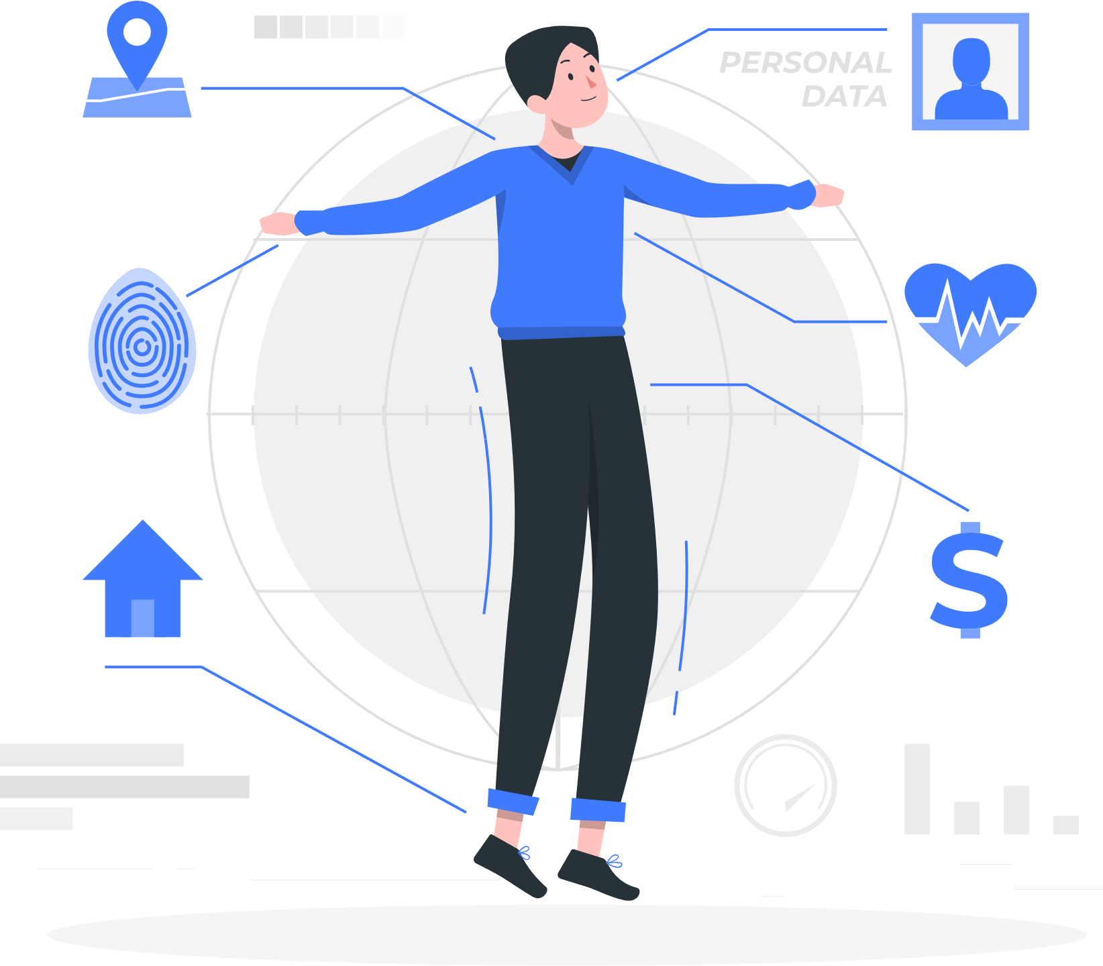
Personalization will be the key differentiating factor among consumer goods brands. Companies now have a golden opportunity to develop innovative ways to deliver hyper-personalized goods to increase sales and utilize voluntarily-provided customer data.
People want recommendations from friends who know them, they want to take advice from experts, and they want products that reflect them. Big data is opening up the ability for manufacturers to be their customers' expert friend, who can make the exact product that they need. A growing portion of consumers is now happy to volunteer their personal information to manufacturers in exchange for a product that reflects them as individuals and is optimized for them.
Personalization does not evaluate users and consumers as groups but as individuals. It takes all the data a user gives, including personal information, real-time information, and contextual data, to tailor the offering to the needs and desires of each person. Hyper-personalization uses more complex and intimate personal data, e.g., location and bio-data, DNA or 3D scans to provide personalized content and experiences. Further, mass customization offers a standard service of allowing a consumer to control the design and functionality of their product.
In this Intelligence Brief, we look at the demand for personalized goods, speak to a Professor of Marketing about the hyper-personalized production of consumer goods, and explore seven important technologies that are enabling personalized production.

Slide 3
Key Takeaways
Understanding hyper-personalization and mass customization
Enabling technologies
01 Additive Layer Manufacturing
02 Collaborative Robotics
03 The Industrial Internet of Things (IIOT)
04 Artificial Intelligence and Machine Learning
05 3D Scanners
06 Wearable Tech
07 Genomics
4
5
11
14
17
20
23
27
30
33
Challenges and risks
How to get started
About the Authors
About the Expert
Potential Next Steps
Other reports from PreScouter
About PreScouter
37
41
42
43
44
45
46
Contents

Slide 4
Key takeaways from this Intelligence Brief
1
Hyper-personalization is already disrupting multiple industries.
2
Consumers are increasingly willing to give personal information, but only for products that provide significant additional value.
3
Hyper-personalized products can help build trust and result in intense brand loyalty.
4
Manufacturers have an opportunity to use data to create unique consumer goods tailored to the consumer.
5
Each industry and company should consider where personalized manufacturing could have most impact. It is not suitable in many cases.

Slide 5
Understanding hyper-personalization and mass customization

Slide 6
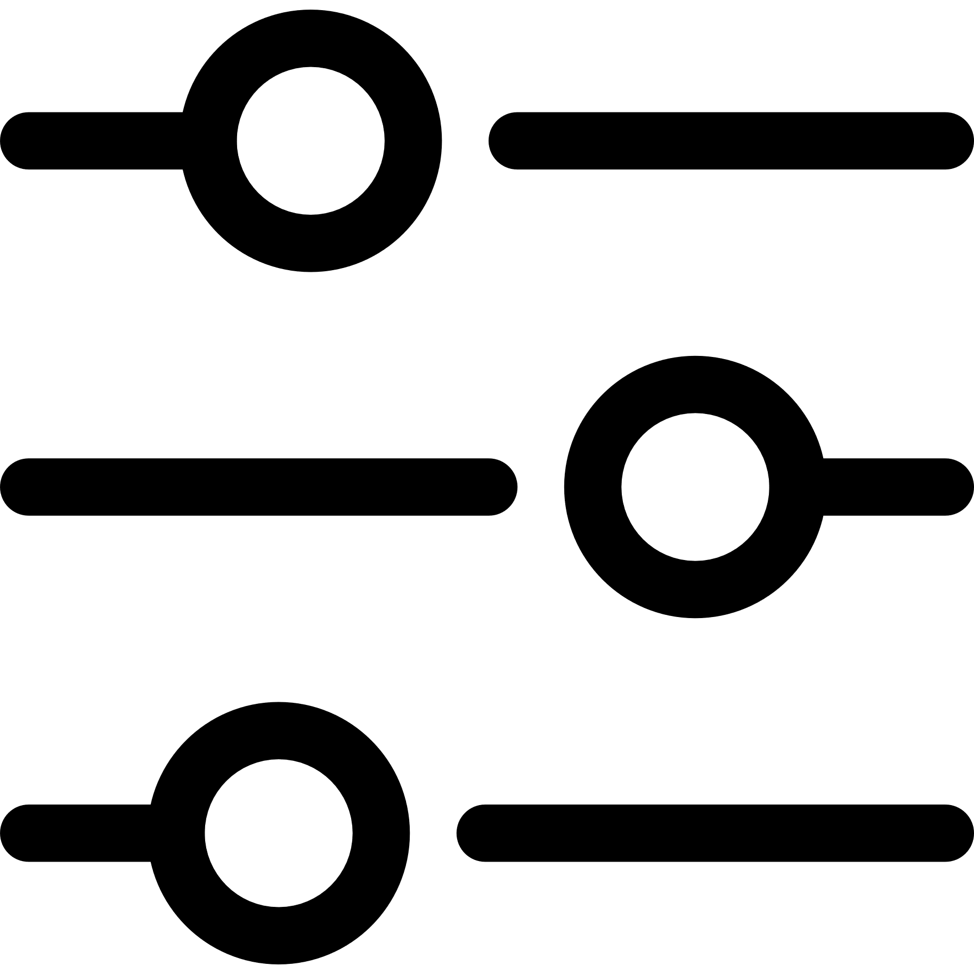
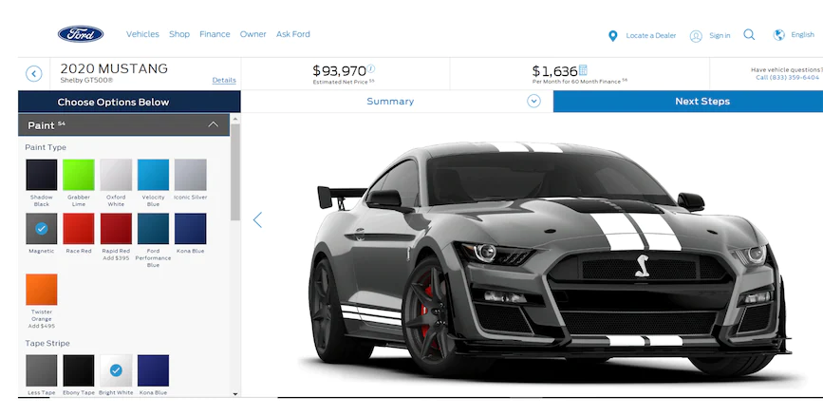
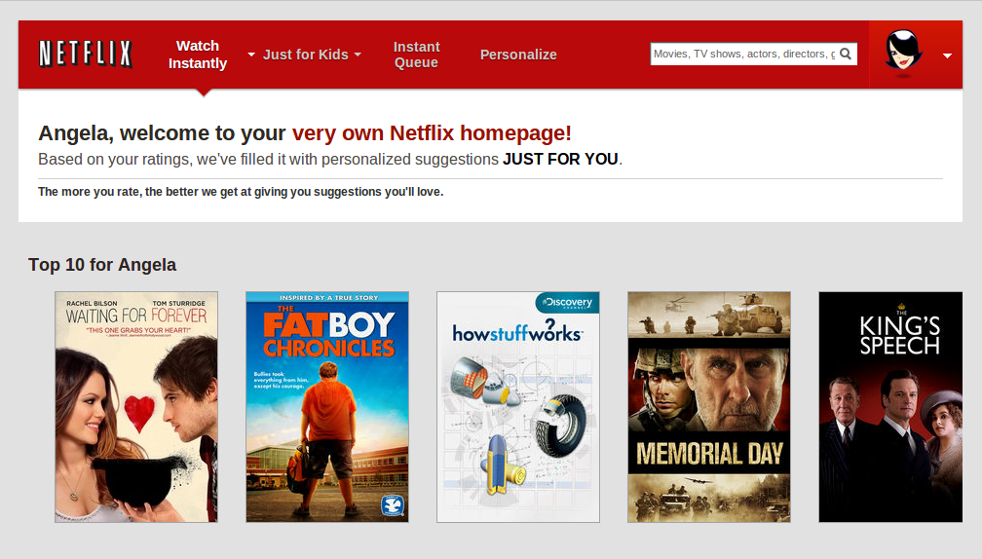
Personalization and customization are slightly different but have the same goal of enhancing the customer experience.
Customization allows the consumer to provide input into the design of the product.
A basic example of customization is when a consumer is able to select the different specs of a car.
Personalization is when a business uses personal information to customize its product for the consumer.
A basic example of personalization is when a streaming service learns what you like to suggest content curated just for you.

Slide 7
The two intersect when manufacturers gather and use personalized data to provide custom insights into how and what they serve the customer.
Customization enables access to personalized knowledge for future interactions.
When a manufacturer enables a consumer to customize their product, they gain insight into the personal desires of that individual consumer. This provides valuable insights that can be utilized for not just the product being customized but also for all future interactions.
Mass-customization provides a unique consumer good to every consumer.
This personalized knowledge enables the production of bespoke products.
With the understanding of the individual consumer, the manufacturer can offer the best selection from a group of products or a personalized product tailored to their exact requirements and desires.
Hyper-personalization allows companies to enhance customer interactions by using individual data to create customized products or services.

Slide 8
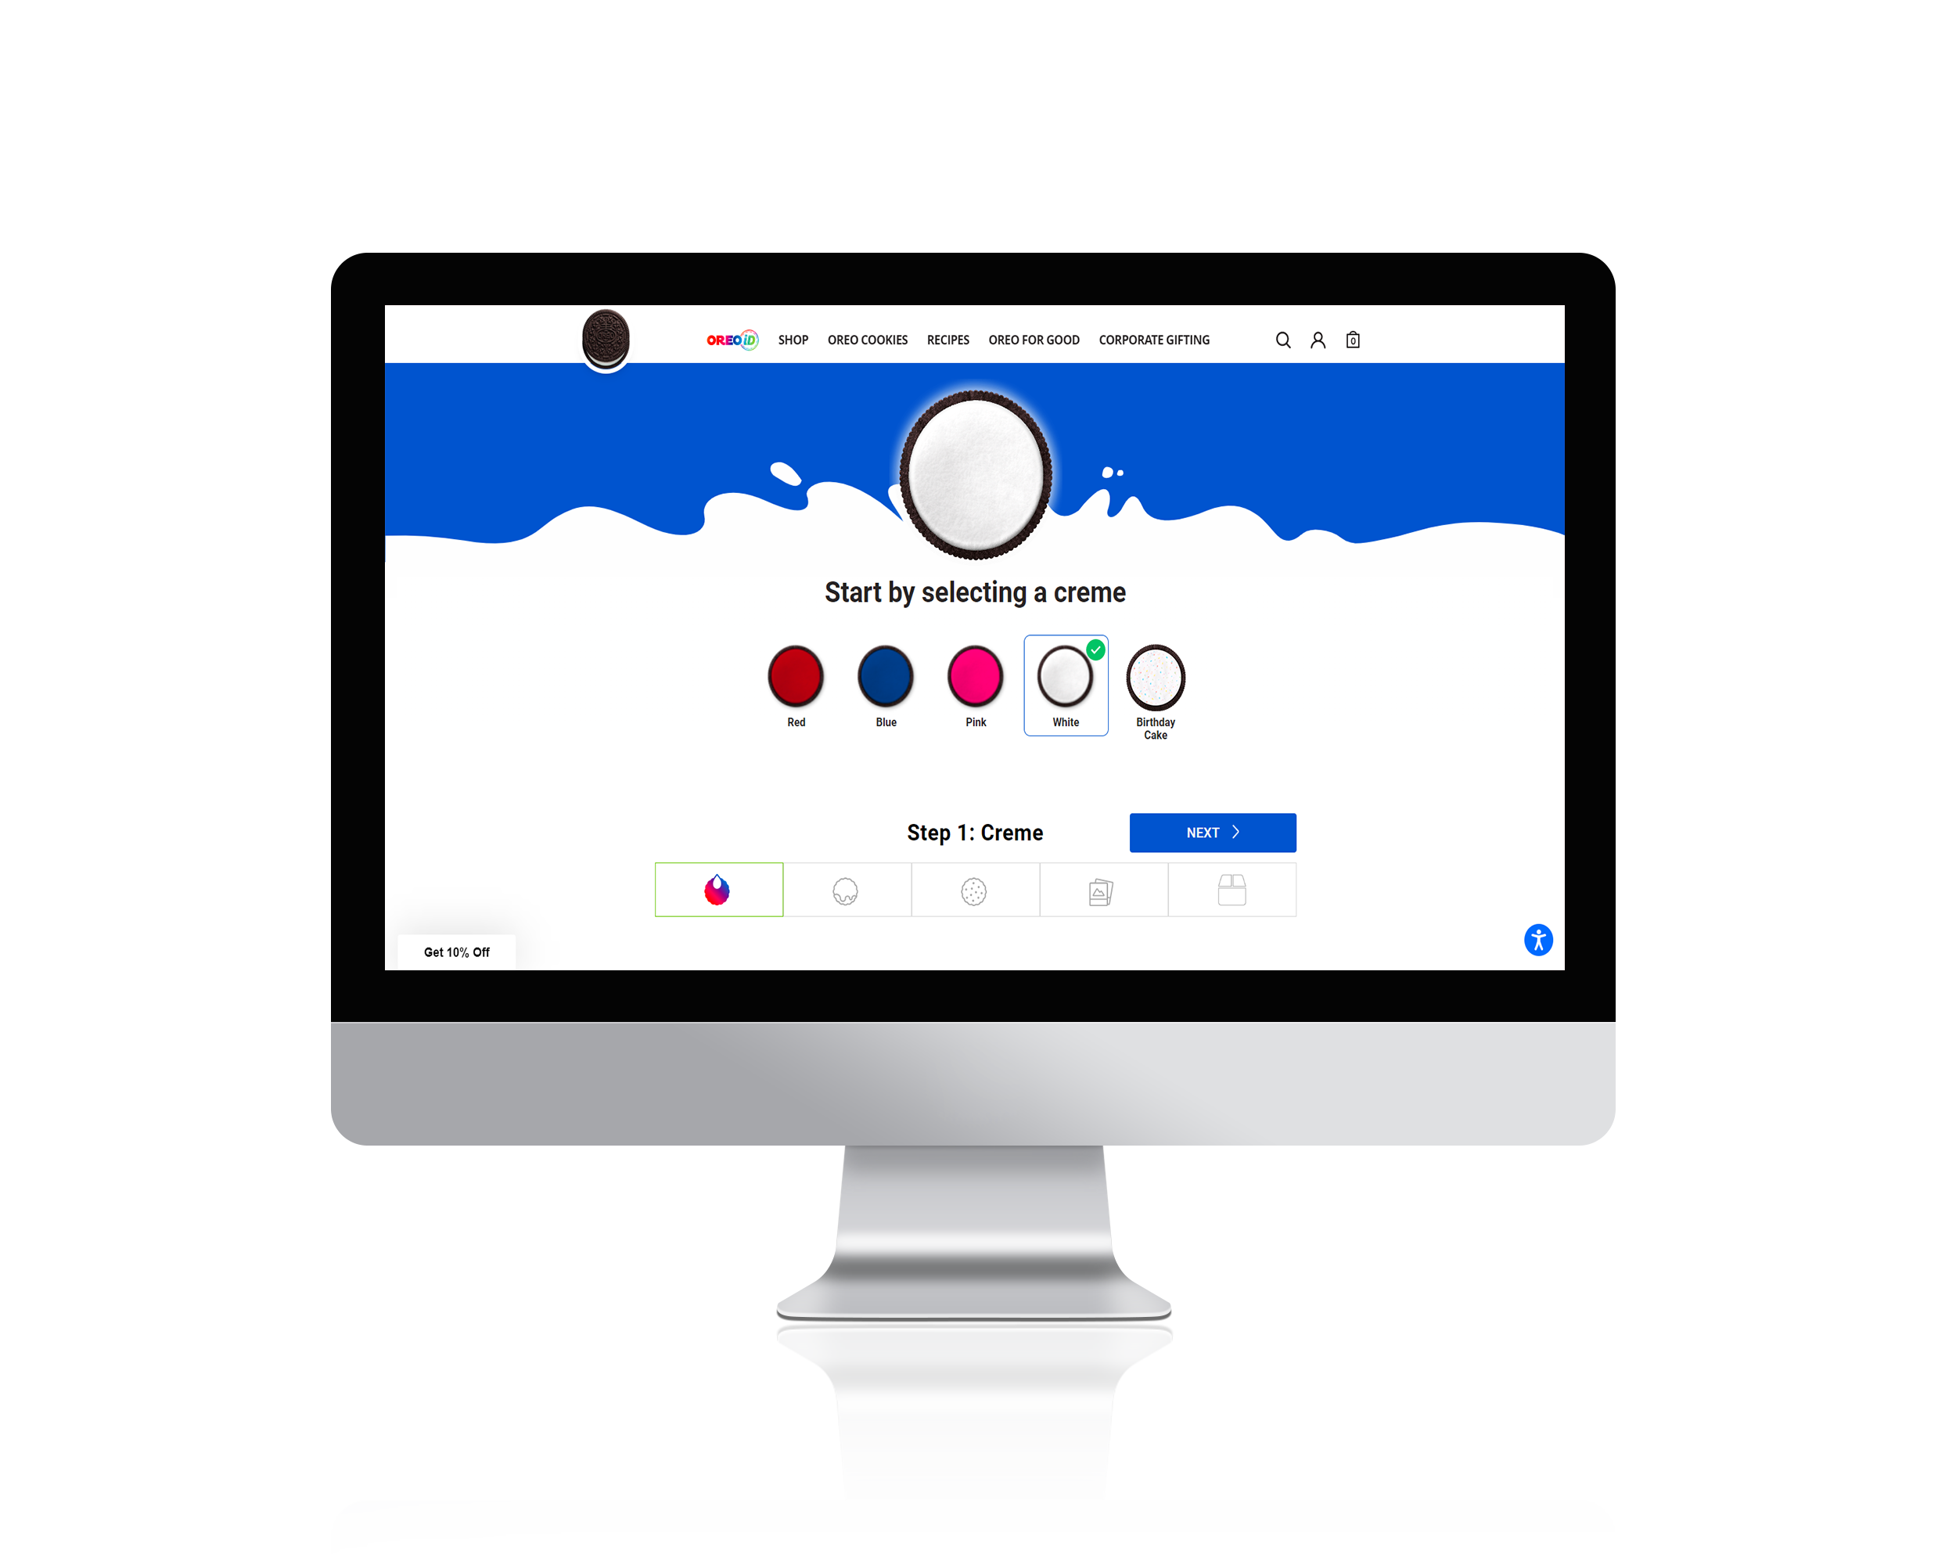
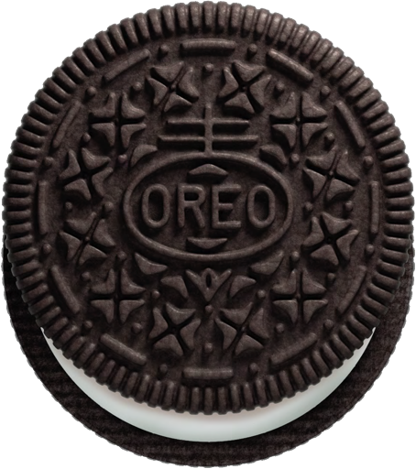
Mass-customization provides a unique consumer good to every consumer.
Manufacturers are increasingly turning to direct-to-consumer channels to build personalized relationships with their customers. By using customer data, manufacturers can offer personalized products that go beyond what resellers can offer.
Even though personalized products are not new, the advancement of certain technologies has made it possible for personalization to become competitive with mass production, potentially disrupting the consumer goods and food & beverage industries.
CPG companies that delay adopting a direct-to-consumer strategy risk losing ground to not only new market entrants but also traditional rivals that are willing to make the change.
A great example of mass-customization that offers personalization has been introduced by the OREO cookie manufacturer, Mondelez. Through their award winning website, OREO iD, customers can choose from hundreds of options to design the flavor, appearance, texture, and packaging of their cookies.
Warned Sudhakar Gudala, the Vice President and Global Head of CPG and Distribution at TCS, in a recent interview with Tata.
https://www.salesforce.com/content/dam/web/en_us/www/documents/research/salesforce-state-of-the-connected-customer-4th-ed.pdf
https://www.tcs.com/perspectives/articles/the-new-era-of-personalization-why-cpg-brands-must-own-the-direct-to-consumer-experience
https://www.oreo.com/oreoid-1

Slide 9
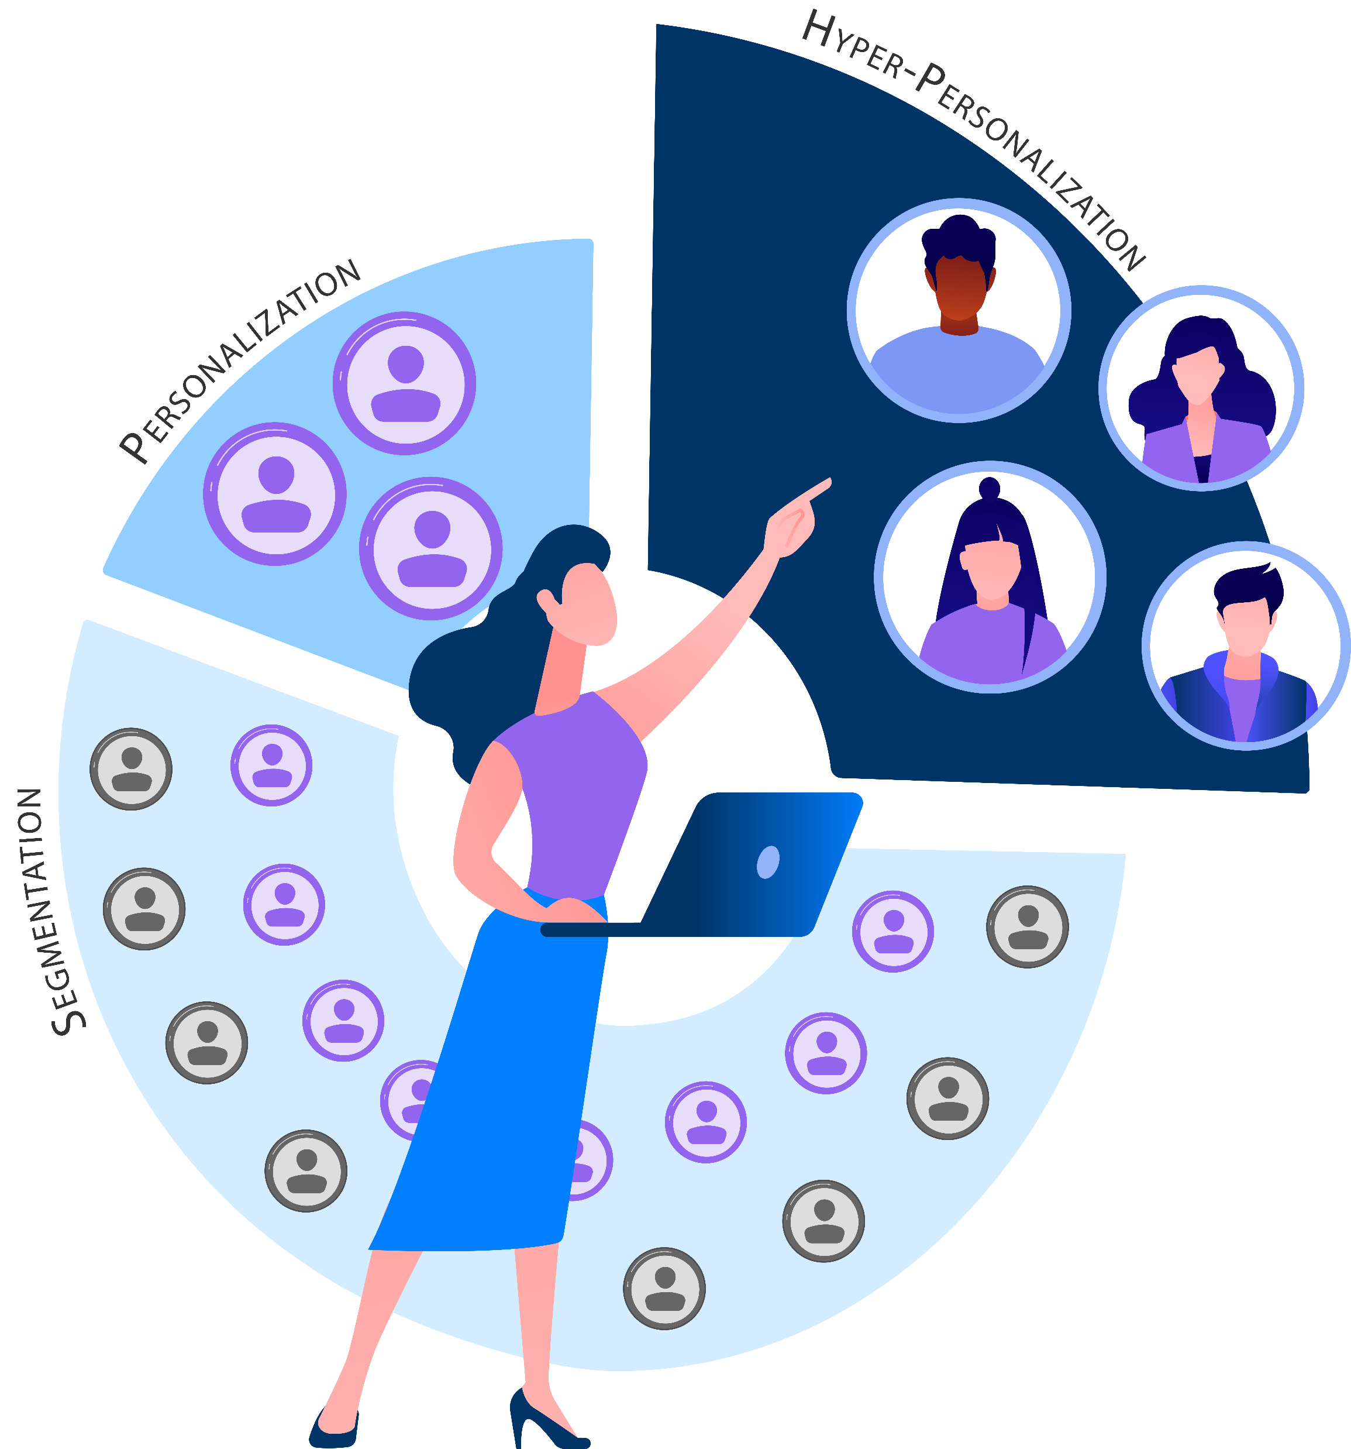
Hyper-personalization allows companies to enhance customer interactions by using individual data to create customized products or services.
Hyper-personalization is becoming a widely-adopted marketing strategy, with 97% of companies seeking to increase their personalization efforts. It involves using data about individual customers to improve the quality of customer interactions and tailor offerings to their specific needs.
This is in contrast to segmentation, which involves grouping people based on shared characteristics. Hyper-personalization goes even further, creating customized products or services for a single, unique individual. Consumers may also provide businesses with personal information in order to receive more personalized offerings. This can include data such as genetics, microbiome composition, and physical attributes.
Hyper-personal information is often used by businesses to analyze and measure customer characteristics in order to better serve their needs.
95% of businesses agree that fully owning and utilizing customer data will be their biggest growth lever over the next three years.
‘State Of Customer Engagement Report 2022’ ²
https://www.salesforce.com/content/dam/web/en_us/www/documents/reports/researchscape-evergage-2020-trends-in-personalization-report.pdf
https://twilio-cms-prod.s3.amazonaws.com/documents/Twilio_SOCER_2022_EN.pdf
https://www.nextupps.nl/voorbeeld-pagina/

Slide 10
Hyper-personalization has opened up a new opportunity in the personalized goods market to drive sales and provide a way to acquire valuable customer data for future product development.
CUSTOMER EXPECTATIONS FOR PERSONALIZATION ARE CLIMBING.
56%
of global consumers expect offers to always be personalized
The demand for personalization is growing. A recent 2022 survey by Salesforce showed that 62% of consumers expect companies to anticipate their needs, up from 56% in 2020. The same survey showed that 73% of respondents expect companies to understand their unique needs and expectations.
Many consumers don’t feel that companies are meeting their personalization expectations. We believe this creates an opportunity for businesses to monetize. A 2020 study by Salesforce found that 63% of consumers expect companies to understand their unique needs and expectations, but only 34% of people felt they were treated as unique individuals by companies.
Considering again the OREO iD website, not only did OREO enjoy record sales from their new venture, they are gathering customer information with every sale, building the required data for hyper-personalization, should they want to go down this route in the future.
73%
expect companies to understand their unique needs and expectations
62%
expect companies to anticipate their needs
56%
feel most companies treat them as a number
The Deloitte Consumer Review Made-to-order: The rise of mass personalization
https://www.salesforce.com/content/dam/web/en_us/www/documents/research/salesforce-state-of-the-connected-customer-4th-ed.pdf
https://www.salesforce.com/content/dam/web/en_ie/www/PDF/state-of-connected-customer-fifth-ed-comp.pdf
https://www.oreo.com/oreoid-1
https://www.borngroup.com/views/hyper-personalization-mass-customization-and-the-demand-for-unique-experiences/

Slide 11
Expert Insight
Product customization always increases the value benefit for the consumer. In the consumer goods space, we have looked at customized cosmetics, vitamins, and meal plans based upon hyper-personalized data, for example DNA. I believe this level of customization based upon hyper-personalized data would lead to intense product loyalty.
Prof. Mark S. Rosenbaum, Professor of Marketing

Slide 12
Enabling Technologies

Slide 13
Additive Layer Manufacturing
Genomics
Additive manufacturing (including processes such as 3D printing) is the process of layer by layer construction of a computer aided design.
The study and use of genetic data to provide insight into the individual.
Collaborative Robots (CoBots)
Wearable Tech
The study and use of genetic data to provide insight into the individual.
Devices that detect, analyze and/or transmit information about the user whilst being worn.
7 Techs Enabling Hyper-personalization
The Industrial Internet of Things (IIoT)
3D Scanners
Interconnected network of communication within manufacturing between machines and people.
3D Scanners covers multiple technologies that enable the capture of 3D space into computer aided design images.
Artificial Intelligence & Machine Learning
AI is the ability of a computer system to use maths and logic to simulate the reasoning that people use to learn from new information and make decisions.
7 enabling technologies opening up hyper-personalized manufacturing.
Based on: Madsen, Stine & Nilsson, Lars & Lindblad, Ellen & Palm, Ellen & Nielsen, Tobias. (2018). Pathways to sustainable plastics - A discussion brief, and Law, K.L., Narayan, R. Reducing environmental plastic pollution by designing polymer materials for managed end-of-life. Nat Rev Mater 7, 104–116 (2022).

Slide 14
Recent advances in multi-material additive manufacturing promise to open this technology up to the manufacturing of more complex products, including electronics and mechanical components.
01
ADDITIVE LAYER MANUFACTURING

Slide 15
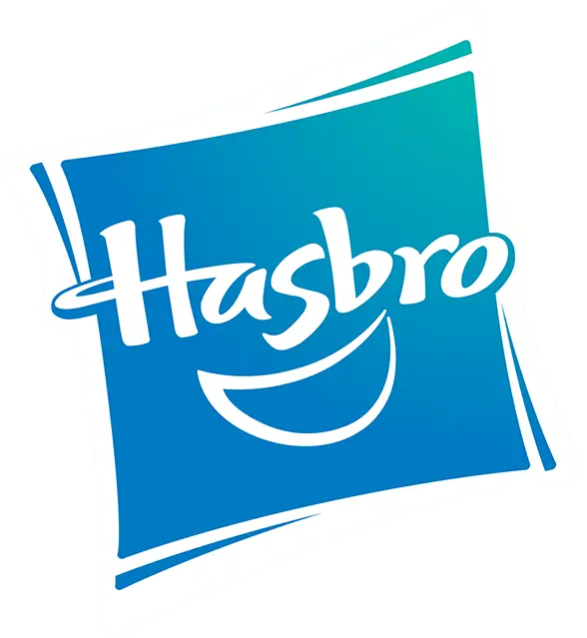
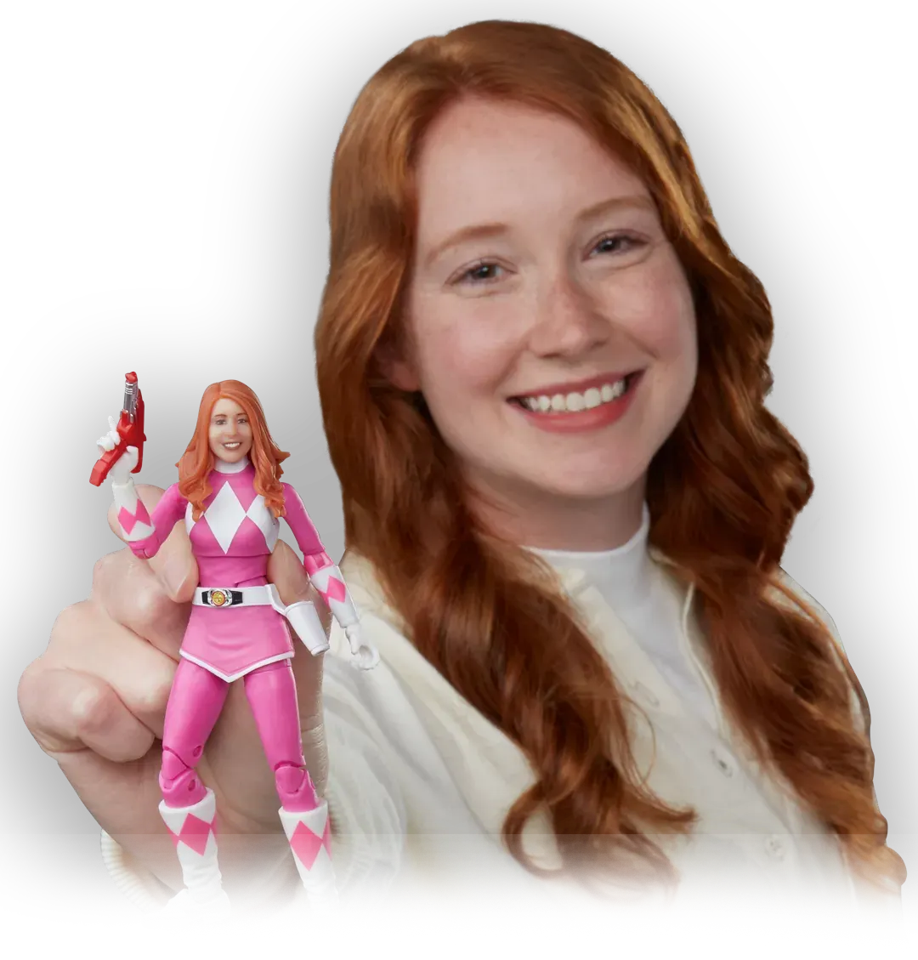
3D printing enables on-demand manufacturing of high-quality, highly personalized solid product components.
Hasbro is a great example of combining 3D printing with the latest 3D scanning technology. The Hasbro Selfie Series allows customers to put their faces on the action figurine of their choice.
This can be done by fusing, solidifying, curing, or depositing material to construct the desired shape design. Different materials can be used including polymers [Polycarbonate (PC), acrylonitrile butadiene styrene (ABS), poly ether ester ketone (PEEK), polyetherimide (ULTEM) and Nylon], metals [Titanium, steel, stainless steel, aluminium, copper, cobalt chrome, titanium, tungsten and nickel-based alloys and precious metals], minerals [concrete, marble, granite, clay or even glass].
The CAD design upon which the manufacturing commences can be created by direct interaction with the consumer in real-time. In doing this, the manufacturing process moves from a supply-centric to a consumer-centric process; the consumer initiates production.
Source: Hasbro
To the fan, we're delivering one figure. There's nothing mass about it. You're going to get the figure you want, with the hairstyle that you want, with your face on it. You are becoming that action figure.²
Brian Chapman - Head of Global Design and Development - Hasbro
DOI:10.1109/MPUL.2013.2279617
https://formlabs.com/uk/customer-stories/hasbro/

Slide 16
CASE STUDY
Sonova hearing aids
How it works:
Step 1
Scanning: An audiologist takes a silicone mold of a patient’s ears that are then scanned to make high-resolution 3D computer-aided designs.
Step 2
Modeling: The audiologist sends these images to be modeled to find the proper geometry for comfort and function for each customer.
Step 3
3D printing: Sonova then uses a form of 3D printing called stereolithography to make each in-ear piece.
Sonova is a global leader in innovative hearing care solutions: from personal audio devices and wireless communication systems to audiological care services, hearing aids and cochlear implants. The company was founded in 1947 and is headquartered in Stäfa, Switzerland.
The global market value for hearing aids is approximately 2 billion dollars.
The annual production price increase is about 8%.
Each piece is made to order so this is environmentally beneficial also. The process provides a better product and reduces waste.
Personalized products now dominate the in-ear market.
DOI:10.1109/MPUL.2013.2279617
https://formlabs.com/uk/customer-stories/hasbro/

Slide 17
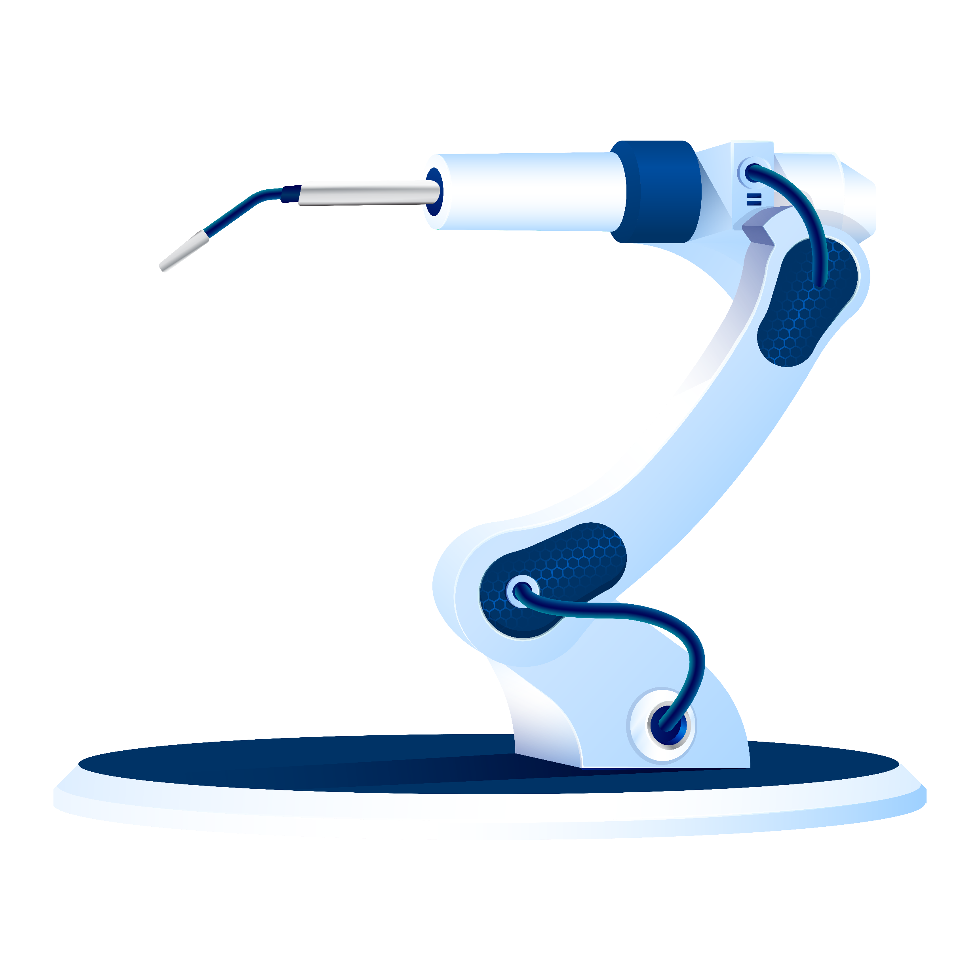
These new power tools enable craftsmen to work with incredible speed and accuracy to deliver personalized touches to products.
02
COLLABORATIVE ROBOTICS

Slide 18
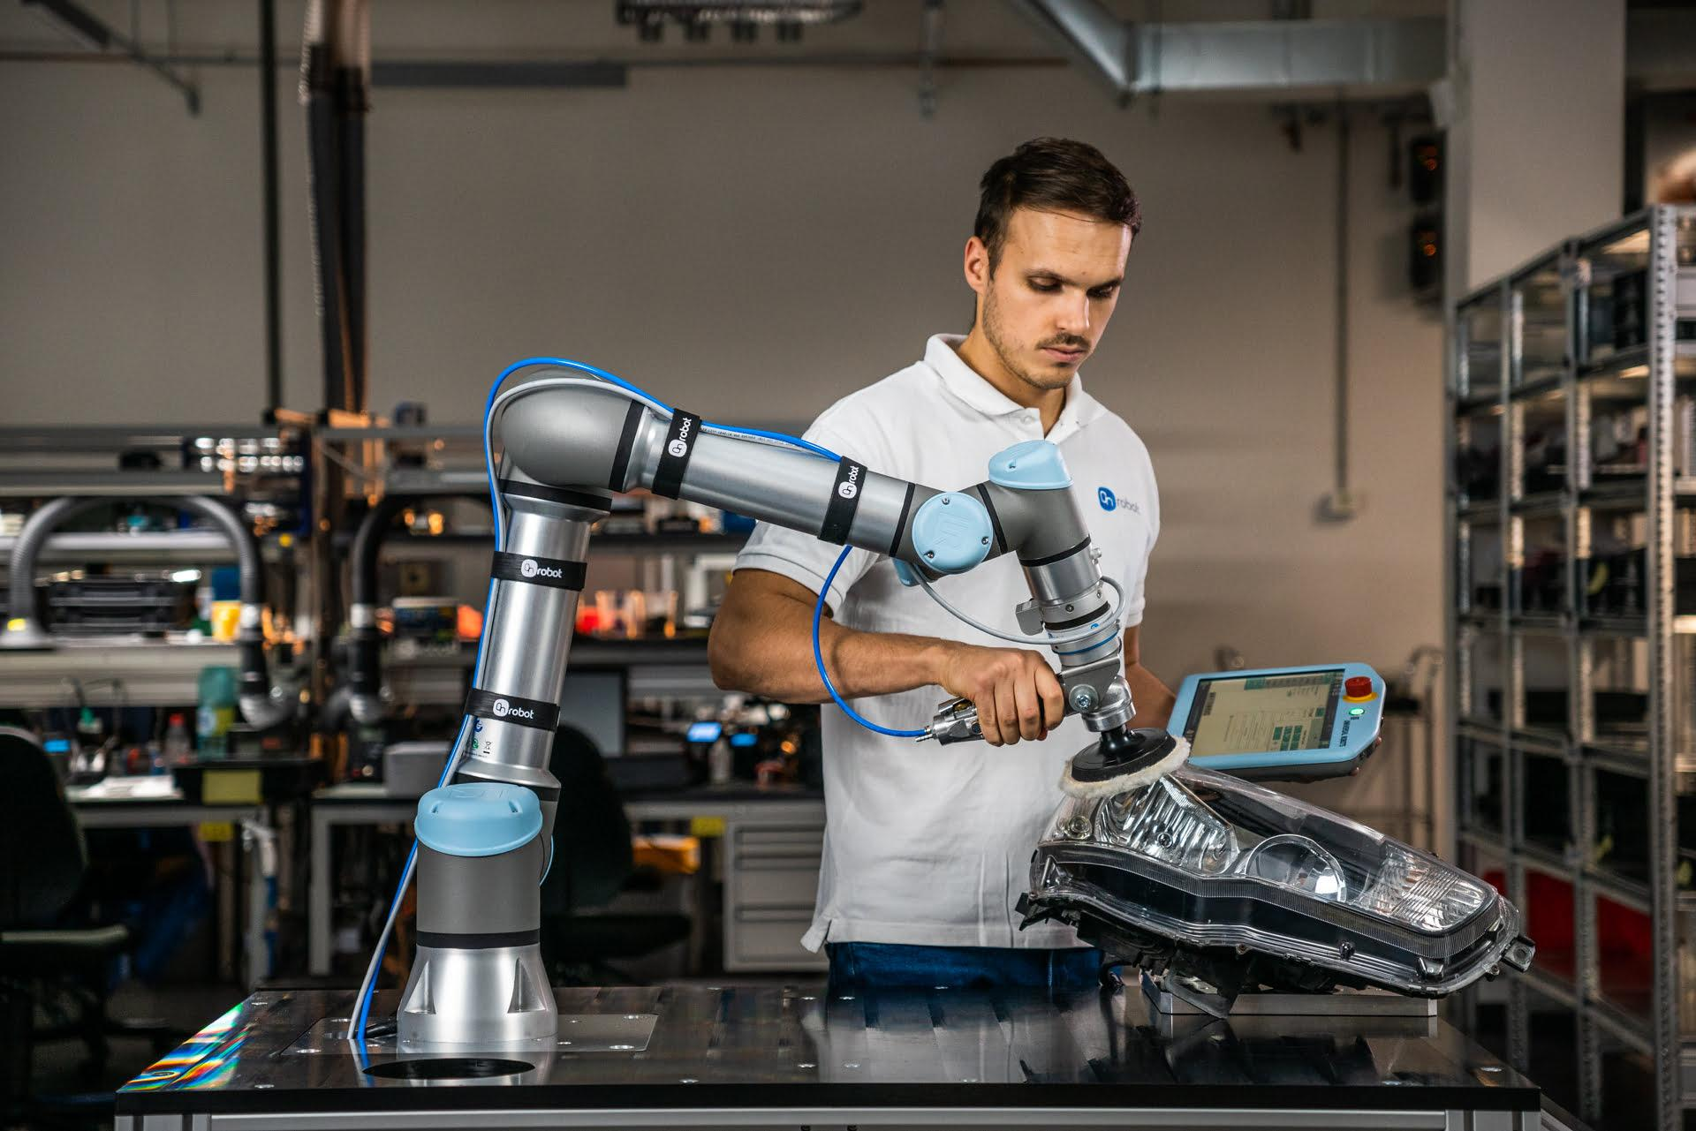
CoBots free up time to produce more customized products. They are especially helpful in making handmade personalized goods.
Missed Opportunity: Etsy (etsy.com) and Personalization Mall (personalizationmall.com) have built their businesses on the desire for customized handmade products. However, both Etsy and Personalization Mall rely on individual craftspeople to customize or personalize their effects one at a time, and the products often demand a significant premium relative to the mass-produced equivalent.
Collaborative robots are now readily available to solve this problem, with prices accessible to small enterprises.
Consumers often still want the input of a craftsperson in their product creation, as well as personalization. The desire for a handmade product indicates high status and a connection to the tailor-made products of the past.
When the consumer wants this, collaborative robots are the modern-day power tools that give the craftspeople superhuman abilities in terms of speed and accuracy. CoBots can move and collaborate with other moving or static robots to perform simple tasks such as drilling, welding, and gluing, as well as pick & place or quality testing. CoBots are able to work 24 hours a day and can interact with humans.
ABI Research estimates that the CoBot arm industry is set to grow into a $11.8Bn market by 2030.¹
https://www.abiresearch.com/press/collaborative-robot-market-will-exceed-us11-billion-2030-representing-29-total-industrial-robot-market/
https://www.universal-robots.com/case-stories/bw-industrie/

Slide 19
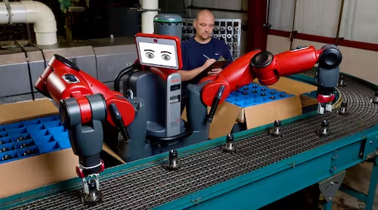
CASE STUDY
DuCo Ceramics Company
Du-Co Ceramics Company is a manufacturer of technical ceramic products serving the global market of customers requiring precision made ceramic components produced from a variety of ceramic materials for a wide range of applications.
Du-Co Ceramics manufactures hundreds of unique parts every day through different processes including drilling, tapping, slotting, and threading before firing.
Du-Co Ceramics partnered with Rethink Robotics, which installed ‘Baxter’, a collaborative robot, to automate the more straightforward tasks in their manufacturing process. Baxter is trained as you would train a person by demonstrating what you want him to do. It contains cameras and sensors that enable it to “see” objects, “feel” forces, and “understand” tasks. ²,³
Letting Baxter carry out simpler tasks frees up the time for the employees to focus on more complex, creative tasks.
Source: Electronicdesign
There’s a time in the not-too-distant future where every custom parts producer will be deploying this type of technology.
Josh Rupp, Process Engineer at Du-Co told CeramicIndustry.com
https://www.sonova.com/en/story/innovation/3d-printing-technology-improved-hearing
https://trunovate.com/

Slide 20
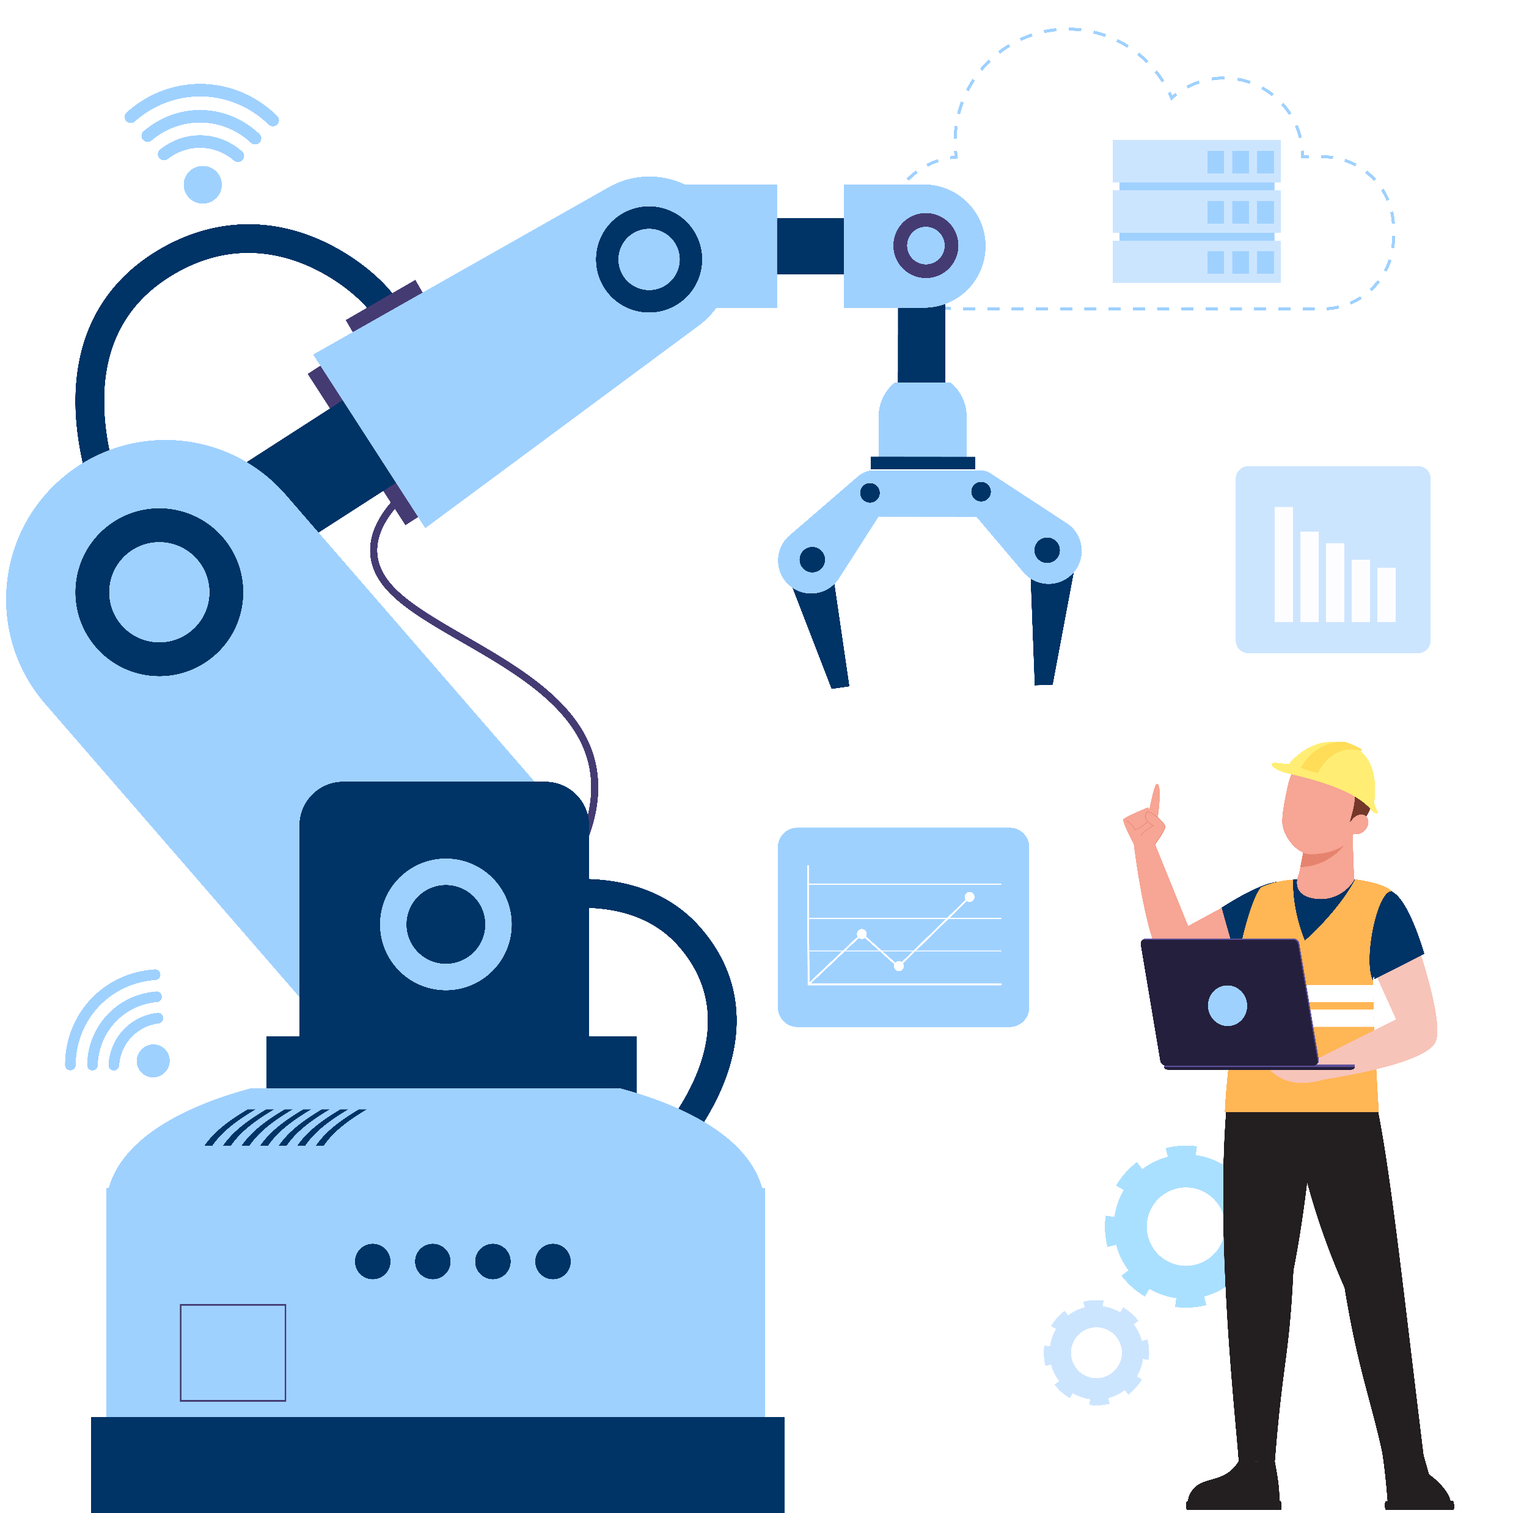
Communication within an interconnected manufacturing facility enables manufacturing of more complex customized products.
03
THE INDUSTRIAL INTERNET OF THINGS (IIOT)

Slide 21
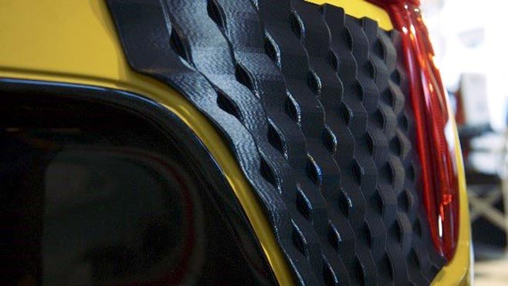
Machine-to-machine communication is a major enabler for large-scale personalized manufacturing.
In 2016, Daihatsu introduced customized outer skins for their Copen 2-door convertible. 3D printing is used to make the part, but the company puts the success down to its on-demand manufacturing process.
On-demand manufacturing is key to personalizing production, where close communication with the buyer triggers parts manufacture.
The idea is transferable to different industries where customers select the desired components in real time. For example, suppliers and logistics providers may view the components that are being ordered and quickly reorganize their systems to optimize their production and supply.
IIoT uses sensors and actuators to create smart machines that can instantly communicate with each other and people to improve manufacturing and industrial processes. Fundamentally, it improves information flow, allowing other remarkable technologies to impact your manufacturing process.
With the use of this technology, data may be sent between the manufacturing floor, customers, and business owners. IIOT is a key technology enabling an integrated manufacturing system, logistics, and supply chain that allows flexible manufacturing and personalized manufacturing at scale.
https://www.techtarget.com/iotagenda/definition/Industrial-Internet-of-Things-IIoT
https://pixelplex.io/blog/iot-in-manufacturing/
https://www.stratasys.uk/resources/case-studies/daihatsu/
https://www.wiley.com/network/professionals/technology-and-innovation/beyond-the-hype-how-the-internet-of-things-iot-enables-mass-customization
Source: Stratasys

Slide 22
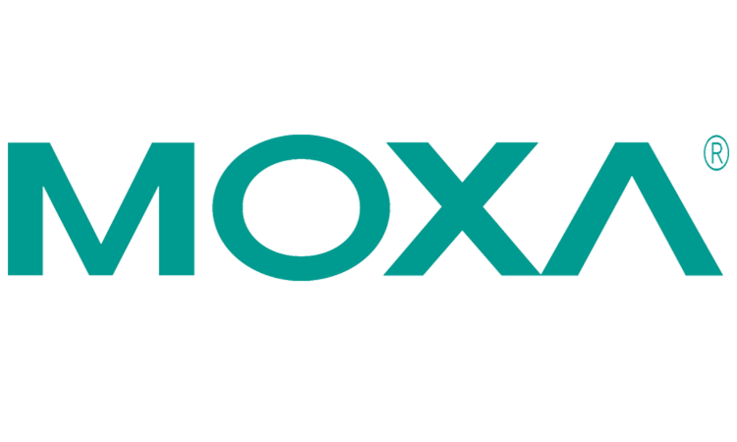
CASE STUDY
Moxa and a Chinese Appliance Manufacturer
A Chinese home appliance manufacturer has implemented IIOT technology in their mass personalization manufacturing set-up. The smart factory needed to transmit real-time data between the central Manufacturing Execution System (MES) and the various stations in the production line.
To enable a seamless process, the MES has to know the production operation of each personalized order, meaning that it has to see where each part is, where that part has to go next, and what has to happen once the part is there.
The supplier of the IIOT system, Moxa, describes the system in a case study:
“Customers design their own appliances which incorporate their style, color, and function preferences. Based on the customized order, the interconnected factory set in motion its manufacturing process automatically, conveying the information to the production line of each process, module makers, and logistic carriers to schedule the equipment, materials, and modules for each production line. Each customized order has to be synchronized with the schedule of each production line. At the same time, customers can check the status of their customized appliances directly.”
Moxa is a leading provider of industrial networking, computing, and automation solutions. Their IIoT enables rapid communication between the manufacturing execution system and each workstation.
Source: Trunovate
https://www.moxanederland.nl/simplify-connectivity/downloads/iiot-case-study.pdf

Slide 23
Companies can provide a unique product by taking information provided by the consumer and personalizing product designs that engage with them, learning with each new interaction.
04
ARTIFICIAL INTELLIGENCE AND MACHINE LEARNING

Slide 24
AI allows companies to turn data into actionable insights and create personalized products for each customer, offering the same level of attention and care as a skilled designer, but at a much lower cost.
The effectiveness of AI and ML in personalizing the interaction depends on the amount and quality of data used. The system performs best when it has data on a customer's actual product use, particularly in industries such as computer games and software, but increasingly in other goods connected to the IoT.
Transfer Learning, a technique that allows a model trained on one task to be applied to another related task with little or no modification, has been used to improve the performance of natural language processing. These new natural language systems can improve customer experience significantly.
Once AI and ML have predicted what a customer wants, the company can adjust its marketing approach and product offerings accordingly.
Personalized offerings, which can be made quickly and easily through flexible manufacturing, can strengthen the company's marketing efforts. This includes hyper-personalization of marketing strategies that use the same data and techniques to increase conversion and customer retention.
Overall, AI and ML can allow for seamless integration of product design and marketing efforts, resulting in a more personalized and satisfying experience for the customer.
The continual interaction between the manufacturer and product is likely to become more prevalent with the rise of the Internet of Things (IoT).
Once you know how the consumer likes to interact with your product, it can be personalized to meet their needs or improve their experience.

Slide 25
CASE STUDY
Electronic Arts
Electronic Arts (EA) is a famous American video game company founded in 1982 in California.
EA's 'Dynamic Difficulty Adjustments' allows them to predict an expected duration of gameplay based on the user's previous activity and change their game's difficulty and gameplay based on the user data collected by the platform.
This can drive in-game, or repeat, sales, as the game is optimized by AI, continually evolving to the user's play style.
Through this approach, the manufacturer can retain access to the product through the use of online interaction. This allows for continual communication between the product and the manufacturer, enabling real-time adaptation of the product to improve the customer experience.
As their 2016 patent notes, "Often, games that are too difficult or too easy will result in less enjoyment for a user. Consequently, the user is likely to play the game less".
By determining the expected gameplay duration, the video game's difficulty level can be automatically adjusted to keep the consumer engaged and enjoying the product. This is ultimately a key driver for the game's success, as it ensures a positive experience for the player, increasing the likelihood of repeat sales.
Player data
Data Collection
Difficulty Optimizer
Game Clients
Personalized adjustment
Player Progression
Dynamic Adjustment Service
Figure. A schematic diagram of the Dynamic Difficulty Adjustment system. Source: Xue et al.
DOI:10.1109/MPUL.2013.2279617
https://formlabs.com/uk/customer-stories/hasbro/

Slide 26
Expert Insight
It is an amazing time to consider implementing hyper-personalization. An increasing numbers of consumers are comfortable sharing personal information - given the promise of unique products that improve their lives.
James Burns Ph.D, Project Architect at PreScouter

Slide 27
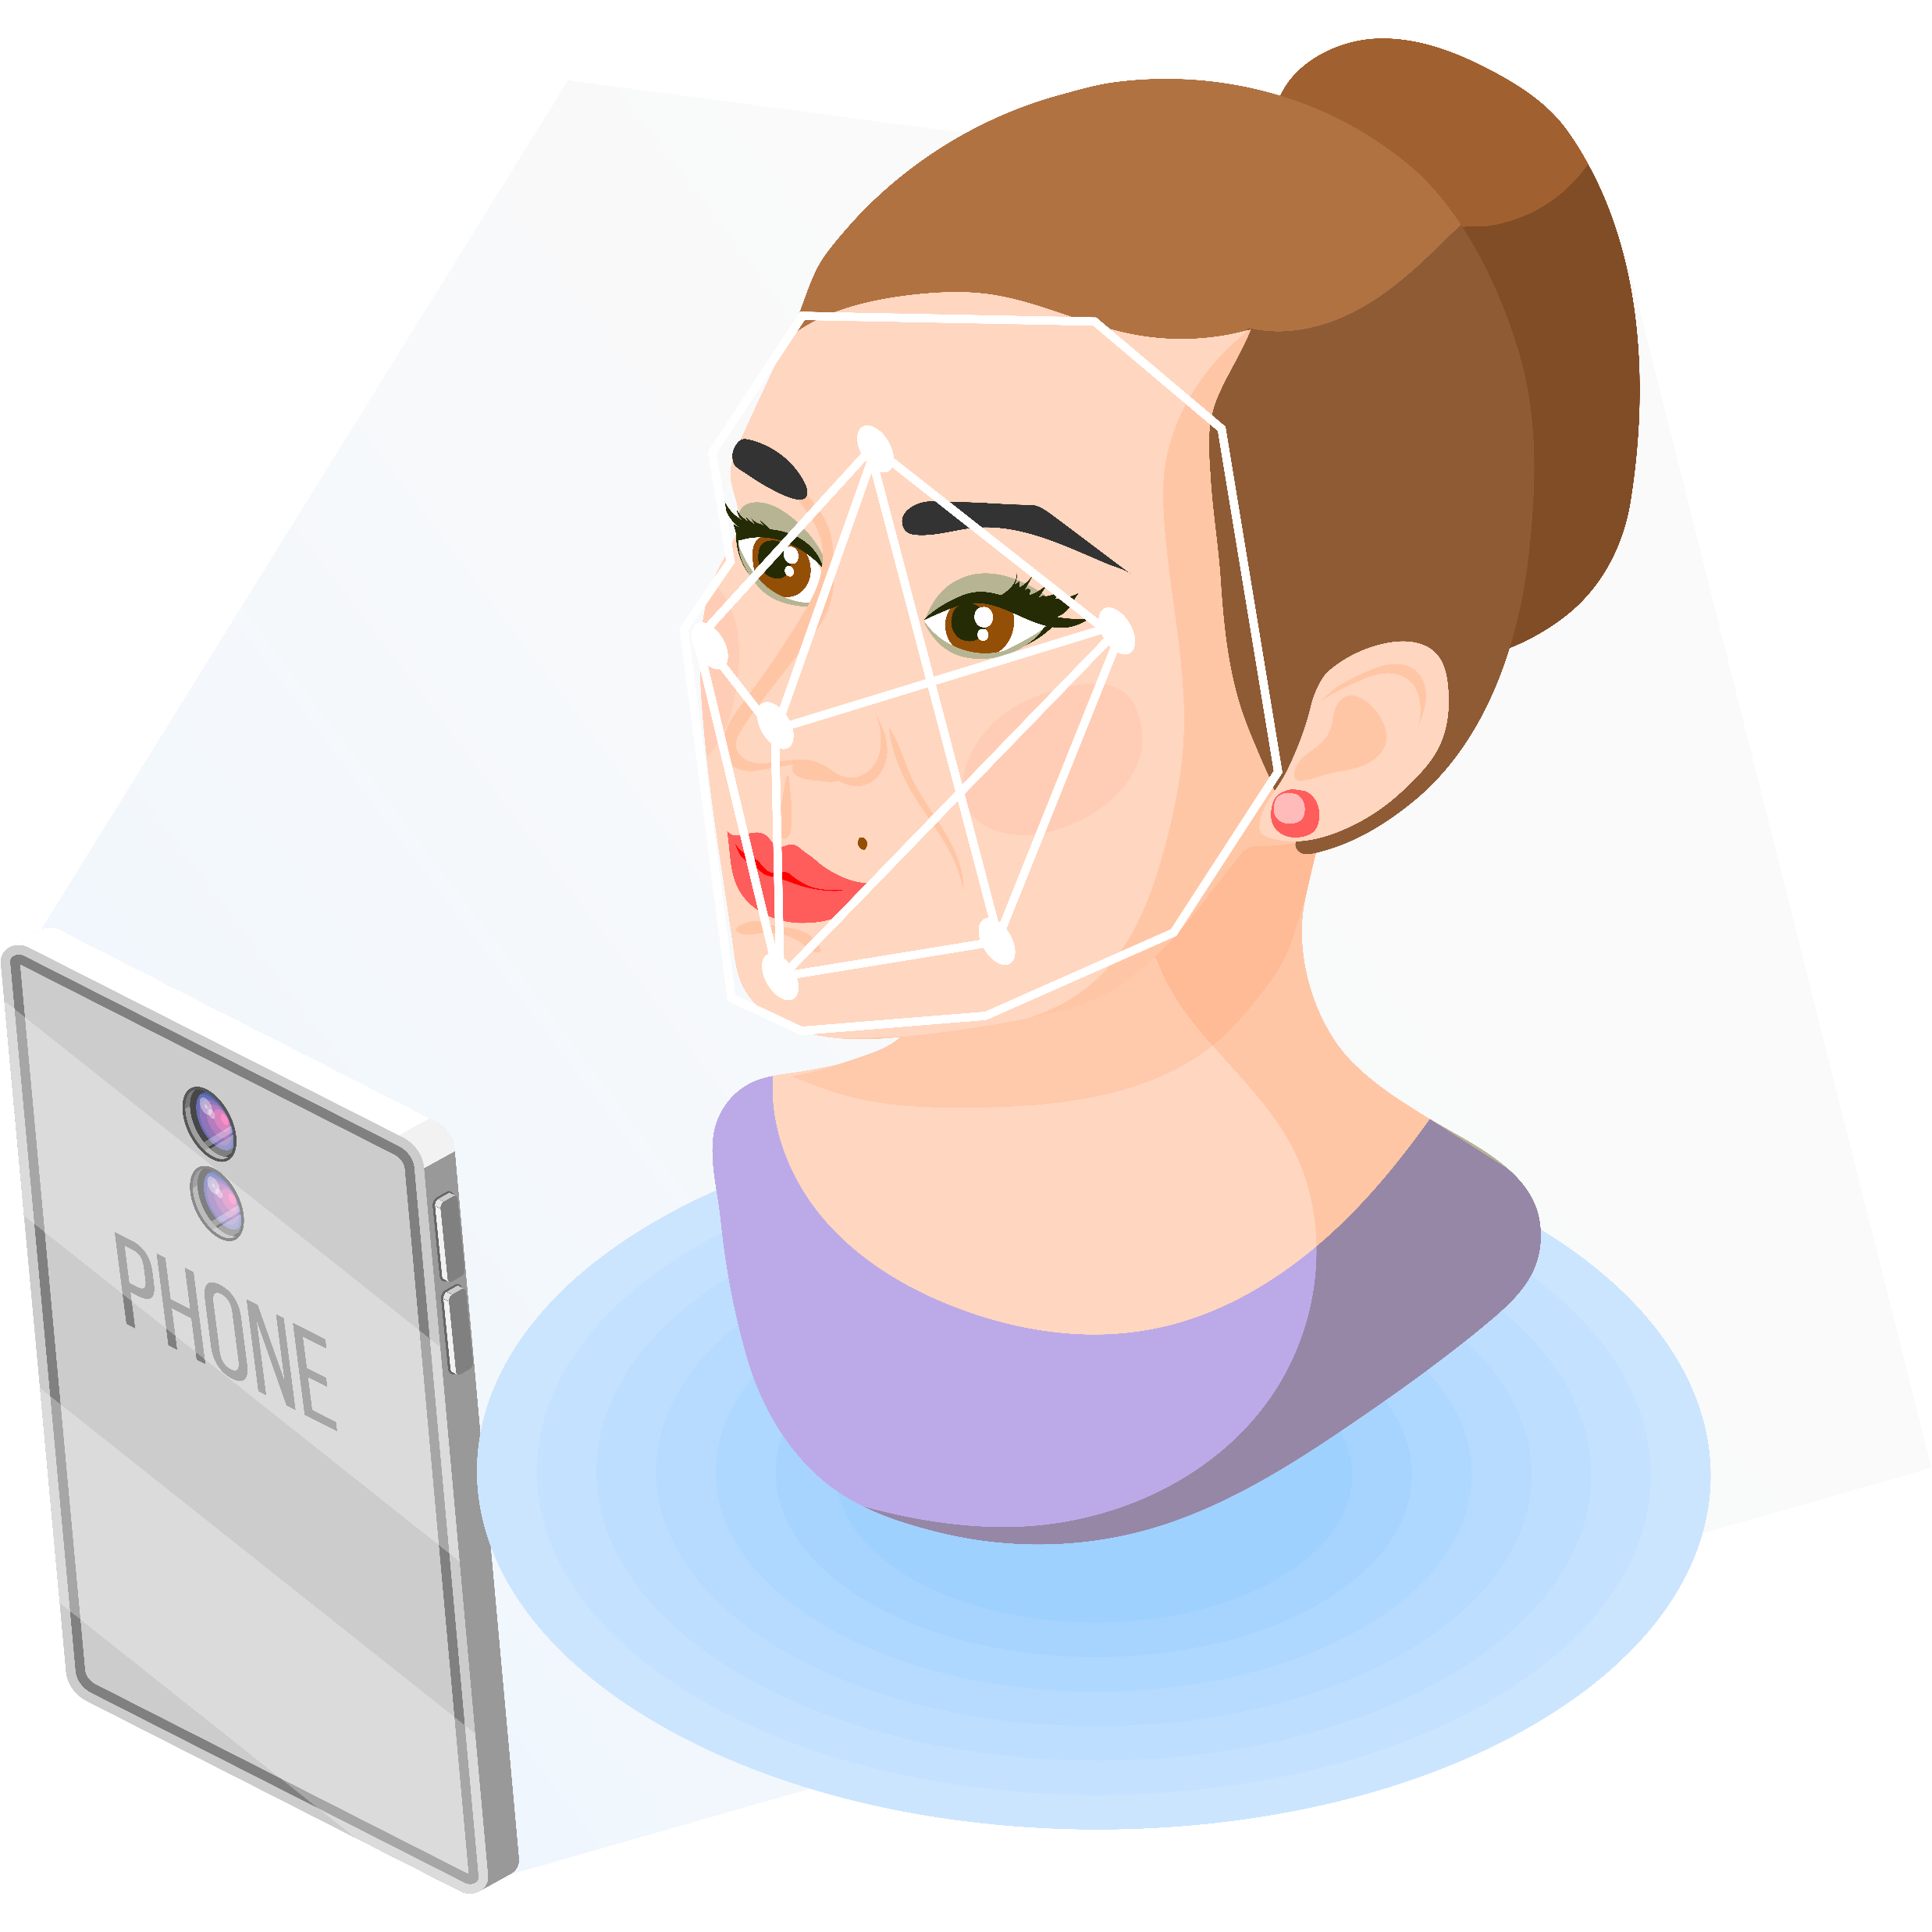
This technology digitally captures the 3D shape information of products, environments and consumers.
05
3D SCANNERS

Slide 28
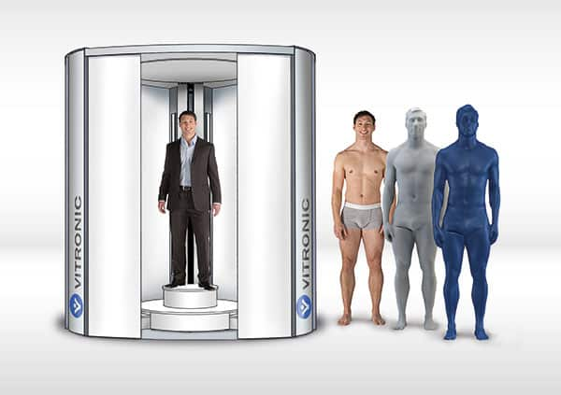
Full-body 3D scanning captures the detailed shape of the consumer for optimized product fit and functionality.
3D scanning covers multiple different technologies that enable the capture of the shape of an object that can be used to build a 3D model.
The scanners do this by capturing the distance of each pixel from the sensor to re-create a wire-mesh model of the scene in silico. Capturing this data from multiple directions enables a complete 3D understanding of an object.
Recent advances in photogrammetry and computer vision technologies mean that they can process photographs taken by the average consumer using a smartphone to construct these 3D images. This has significantly increased the use case for this technology and reduced the barrier to customized mass production.
These technologies can be used to provide accurate size and shape information to tailor anything that interacts with our body to fit and support our contours and unique shapes and sizes.
Figure. The image above represents how 3D scanning can be used to create accurate measurements of a consumer's body and create tailor made clothing. Source: Aniwaa.
https://aksiio.com/aksiio-3d-custom-fit-technology/
https://www.xkelet.com/en/
https://themagic5.com/pages/how-it-works

Slide 29
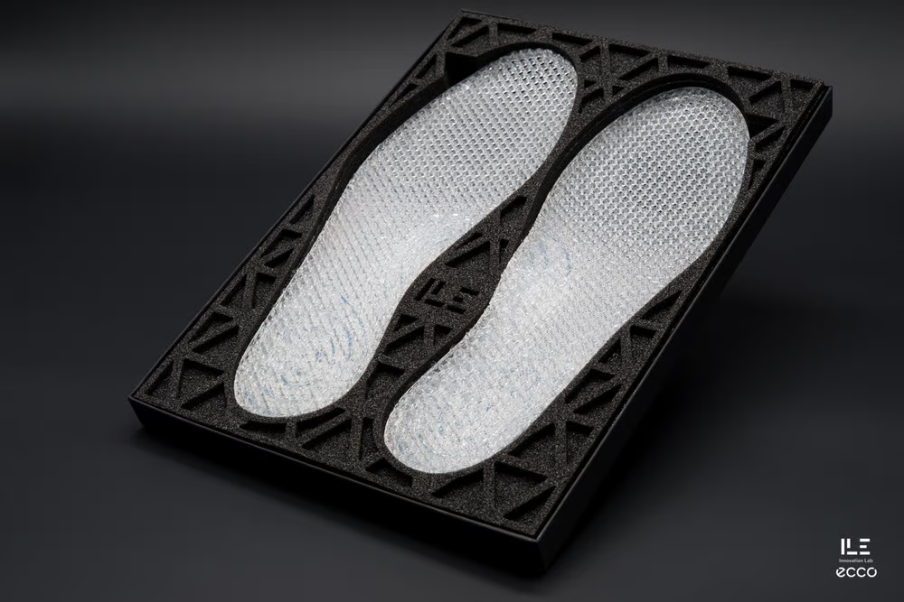
CASE STUDY
ECCO
ECCO uses 3D foot scanning with gait and pressure point analysis to make shoes unique for each of its customers.
After the consumer provides the information using 3D scanning and gait analysis, parts are made with additive layer manufacturing to make made-to-measure shoes.
A silicone footbed is designed based on the shape of your foot and the pressure and impact points in your gait analysis. This uniquely designed silicone footbed is then made for you in-store, with the whole process from scanning to the personalized product taking 2 hours.
Quant-U utilizes a versatile, 3D-printable silicone material that can be adjusted to range from extremely soft and supportive, like memory foam, to highly elastic performance rubber. By utilizing a single material and 3D printing technology, different areas of the footbed can be tailored to individual needs, taking advantage of the exceptional properties of silicone.
Source: Ecco
https://www.quant-u.com/

Slide 30
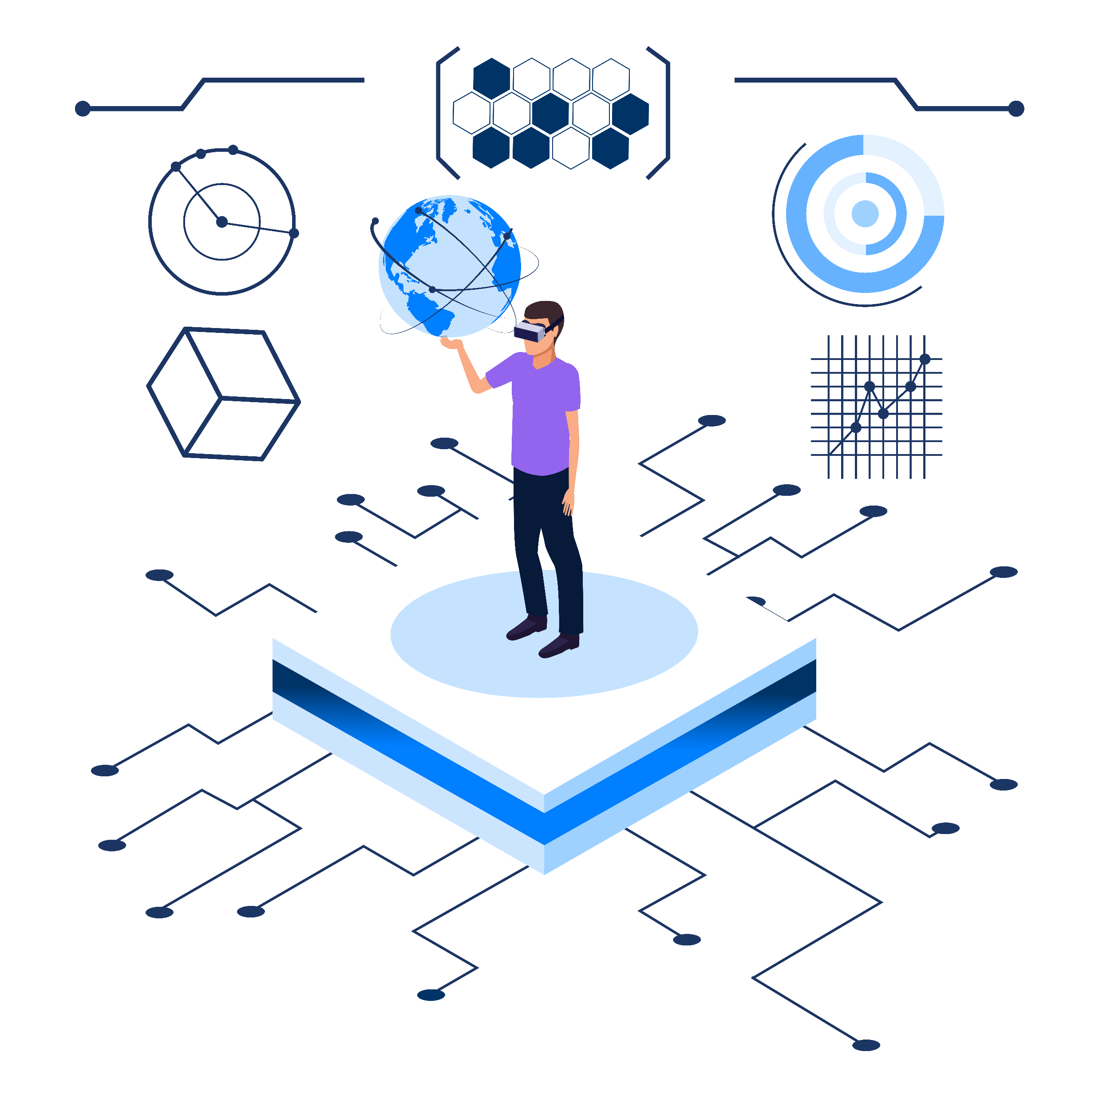
This group of technologies provides businesses with biometric data to develop personalized products, services and dietary plans.
06
WEARABLE TECHNOLOGY

Slide 31
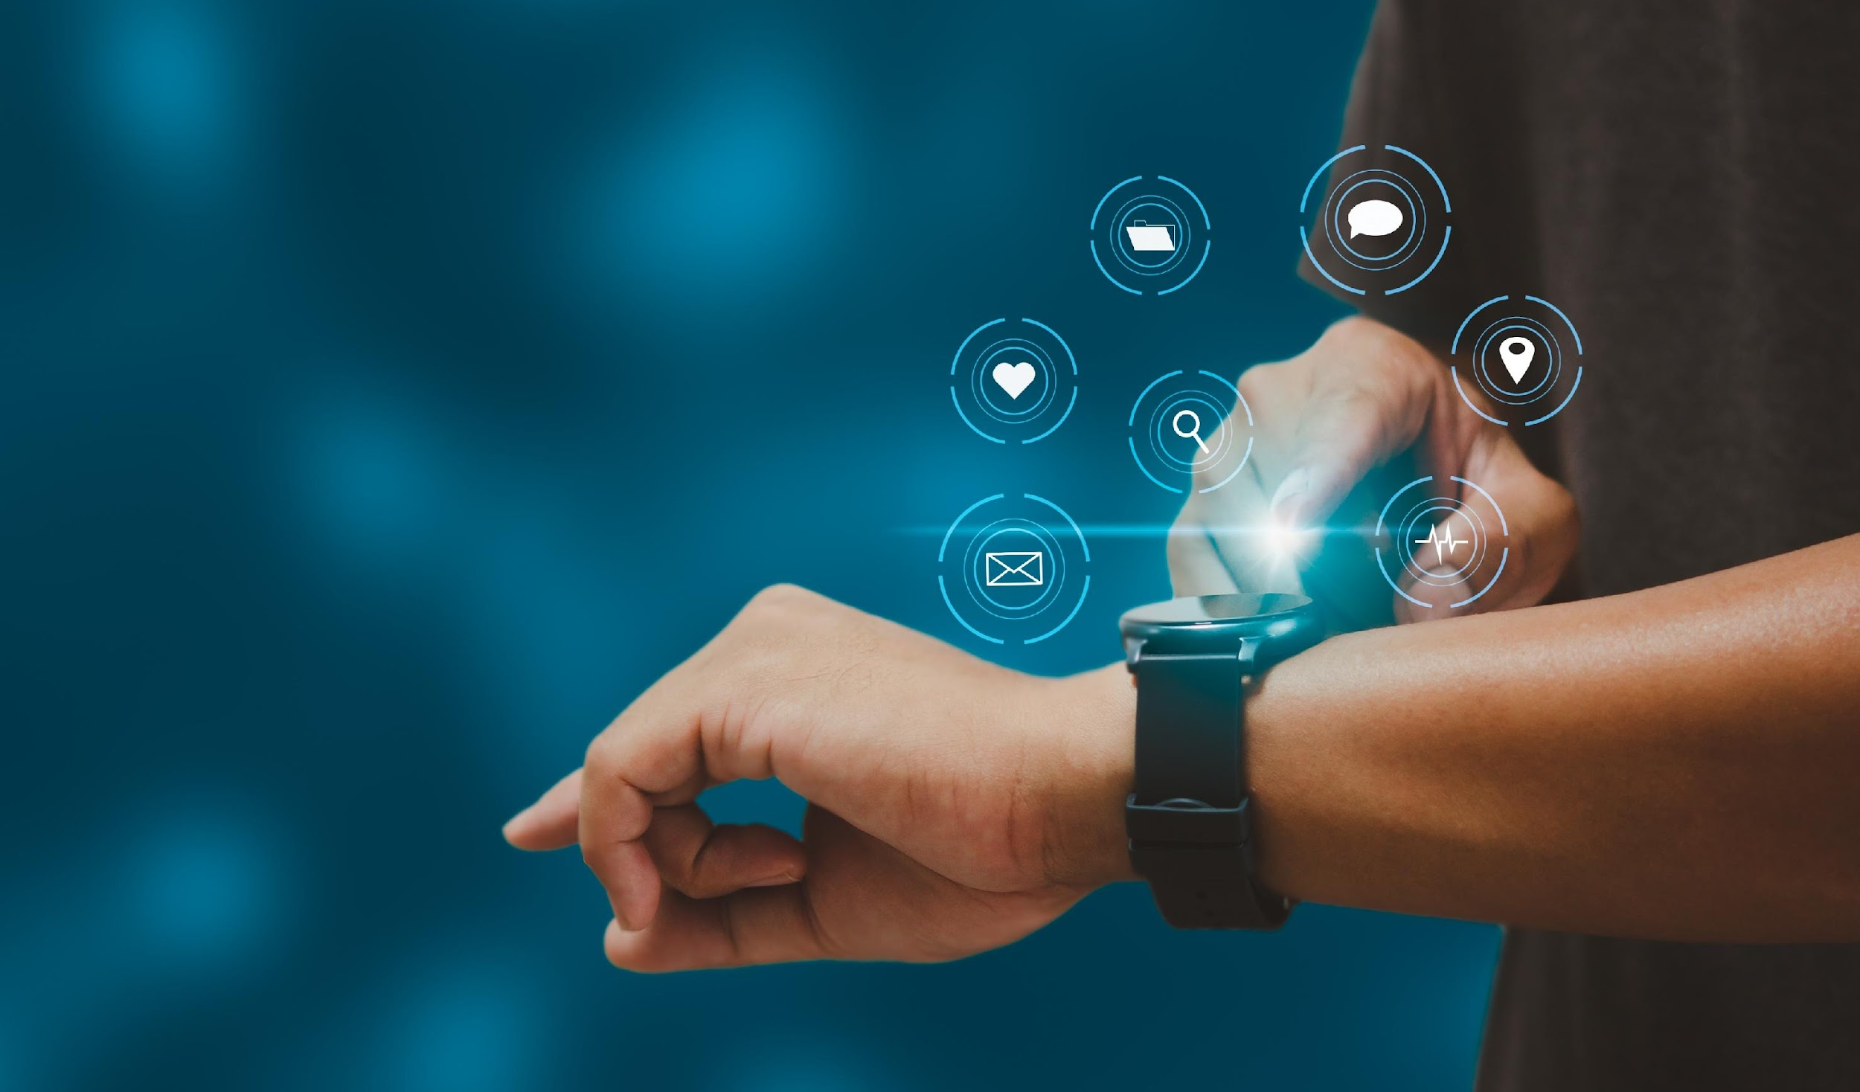
Smart tech analyzes biometrics to generate hyperpersonal data.
For the consumer that wants to be informed about their health and performance, there are excellent opportunities on the market.
Activity trackers and smartwatches are the most common wearable tech used. These are growing more advanced with each release and currently enable tracking temperature, position, and blood oxygen, amongst other measurements. This is opening up new uses;
For example, gyroscopes and accelerometers allow their use in healthcare as an alert system for falls or incidents.
There is also a growing wearable technology space that promises much more, from glucose monitors and other chemicals and biomarker sensors to wearable ultrasound devices that visualize internal organs.
Wearable technology promises to inform the user about themselves, their habits and performance, and their reaction to the world around them.
With this unprecedented quality and amount of personal information, consumers will require businesses to help them understand the information. They will also want to share this information with companies that they can trust to provide a personalized product suited to them.
https://www.capco.com/about-us/newsroom-and-media/the-future-of-insurance-press-release
https://onlinemasters.ohio.edu/blog/how-wearable-tech-is-transforming-a-coachs-decision-making/
https://www.nature.com/articles/d41591-022-00084-2

Slide 32
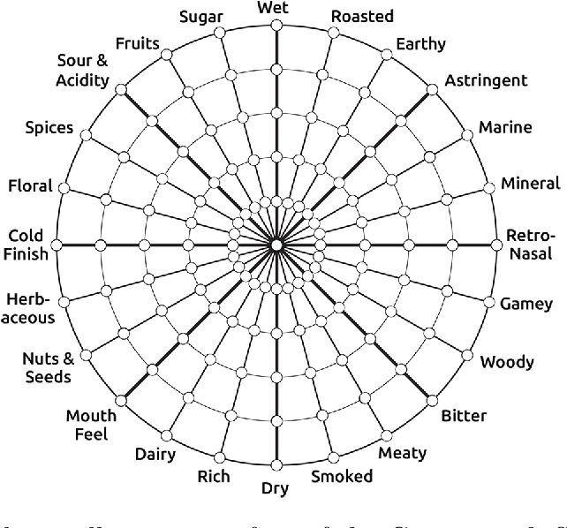
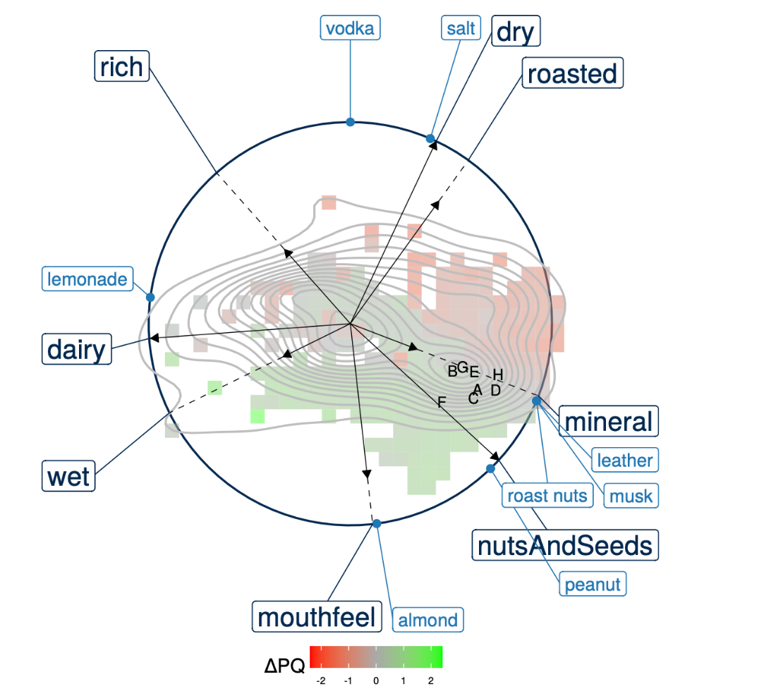
CASE STUDY
Gastrograph AI
Gastrograph AI helps create taste profiles by customer target groups to help companies develop new products and flavors and optimize their market presence.
Gastrograph analyzes tastes, goods, and people. It gathers information on how different consumer demographics throughout the world experience taste. It learns the tastes of certain goods sold on the market in various countries and how to relate those perceptions to those tastes. The AI can predict how specific populations will experience other items.
The company claims that perception and preference predictions are automatically created with little expense and effort after a product has been analyzed in Gastrograph. The platform constantly absorbs new information and data, thus continually improving and updating models.
Gastrograph reports that they have over 30 countries modeled, where they can characterize sensory perception and preference. This innovation is still young, but the potential is unparalleled knowledge to help product managers choose their next export market based on taste profile.
https://www.gastrograph.com/
https://thecounter.org/artificial-intelligence-personalized-food-beverage/
Figure. An example Gastrograph. Source: Gastrograph AI.

Slide 33
Capturing intrinsic information about the individual opens up a new level of personalization.
07
GENOMICS

Slide 34
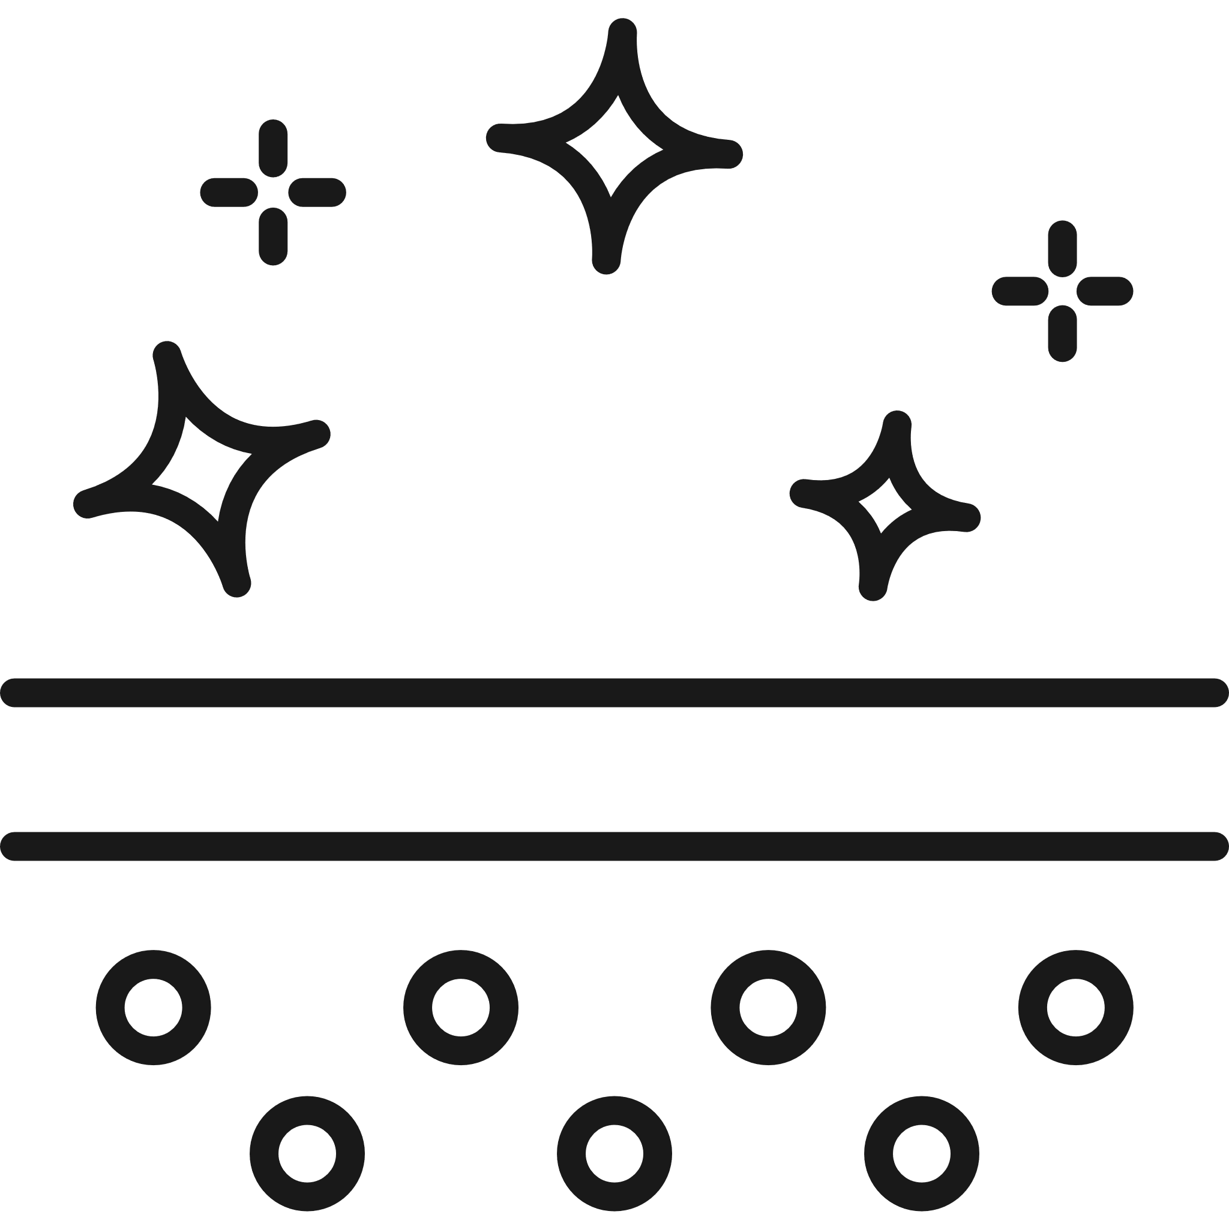
Decoding DNA presents a high-stakes opportunity in many industries.
There are already examples of businesses testing this space in food, drink and skin care where it has the power to disrupt industries and create strong brand loyalty if the product offered has enough value to the consumer.
Consumer genomic testing is marketed directly to consumers, who can buy tests online for as little as $99. After receiving a test kit, customers send the company a DNA sample and receive their results from a secure app or written report. The most popular tests look at a limited set of genes to make predictions about common traits using this genetic information.
While it is not common, it is not niche either, with over 12 million people giving 23andme their DNA as of September 2021.
The promise of personalized healthcare is a value proposition many would give their DNA to achieve.
However, the question for the consumer goods space is whether the genome or other genetic analysis could provide a hyper-personalized product with enough value to justify the intrusion into their privacy.
Personalized Nutrition
Personalized Beer
Personalized Skincare
https://www.ancestry.com/dna/
https://www.23andme.com/dna-ancestry/
https://www.dnafit.com/why-dnafit/
https://www.meantimebrewing.com/blog/2016/12/meantime-bespoke
https://www.epigencare.com/about/

Slide 35
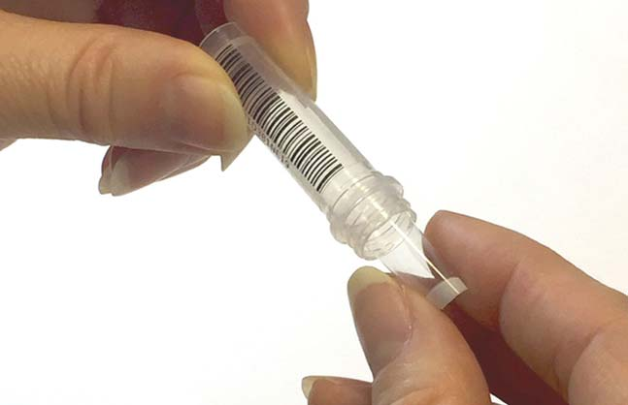
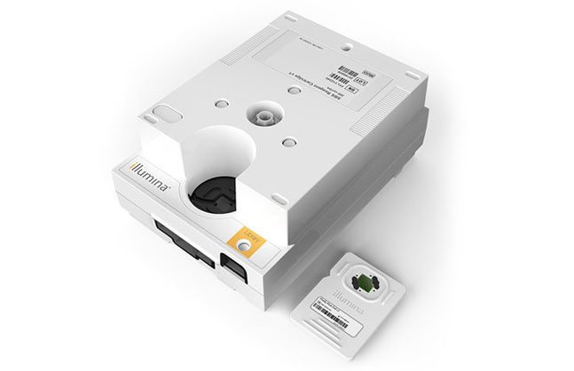
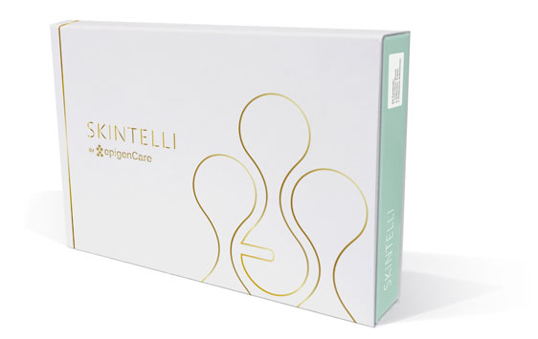
CASE STUDY
EpigenCare and SKINTELLI
EpigenCare is a pioneering epigenetics company looking at scientifically grounded personalized wellness solutions. In 2021, they launched SKINTELLI.
SKINTELLI can help consumers select the product best fit for their complexion based on the epigenetics of their skin. The DNA sample is collected through a simple adhesive process that allows the consumer to collect DNA directly from their skin painlessly.
Rather than analyzing just the genes present, the company focuses on the epigenetic data, highlighting which DNA traits are active or dormant based on the methylation of the gene. The data provides the current capabilities of your skin based on the activated genes, including firmness, elasticity, moisture retention, sun protection, skin’s ability to refresh its cells, sensitivity to environmental stimuli, anti-oxidation potential, and capacity for maintaining smooth and even coloration of the skin.
Based on your data, a selection of ingredients that would be suitable for your profile is selected, and product recommendations can be made.
You can then test again after some time to see if your epigenetics has changed and update your skincare routine accordingly.
Source: Skintelli
https://www.quant-u.com/

Slide 36
Challenges & Risks
Even if mass personalized manufacturing has a lot of advantages, it can have a lot of limitations and challenges for companies that want to please their clients. If a company decides to offer personalized products, it needs to rethink its site design, order processing, shipping, production process, equipment, etc.

Slide 37
Having the right platform/system to offer personalization: the consumer should be able to customize the different dimensions in the ordering system and, preferably, confirm their selections since the product can't be sold again to other customers. It's helpful to have real-time visual feedback that demonstrates modification.
Keeping the standards of excellence/quality: customers want customized products that are of high quality. Materials and components must have excellent quality to guarantee a beautiful finished result; This requires quality integration into the production process.
Production process flexibility: since the process includes working with 3rd party suppliers, managing and communicating effectively with your supply chain is essential. That means selecting suppliers who can provide components easier and quicker.
Delivery time: even if customers are willing to wait for a personalized product, companies must ensure a reasonable delivery time to maintain a good customer experience.
https://startupsloth.om/5-challenges-of-mass-customization/
https://www.reliableplant.com/Read/30506/manufacturing-customized-products
https://www.brushyourideas.com/blog/product-customization-challenges/#section4
https://acceleanation.com/blog/5-ways-to-reduce-operations-costs-with-mass-customization/
https://www.cisco.com/c/dam/en_us/about/doing_business/trust-center/docs/cisco-cybersecurity-series-2021-cps.pdf
Keeping low-cost operations: customization is often associated with higher prices and costs, but with mass personalized manufacturing, there are opportunities to reduce costs. Making products to order and knowing what components are needed means you can order only necessary parts, avoiding waste.
Companies are faced with 5 key challenges when deciding if and how they adopt a more hyper-personalized approach.

Slide 38
People are happy to share very personal information when they see a benefit.
Data privacy is a crucial risk to implementing a hyper-personalization strategy. Most consumers care about privacy and are willing to spend time and money to protect their data. Nearly 50% of participants in the Cisco Consumer Privacy Study 2021 said they had actively avoided or switched from companies because of poor data protection policies or practices.
Therefore, explaining data use and its benefit to the consumer is paramount when considering this strategy.
A 2022 study from the UK found that 77% of people asked were happy to share personal data in general, and 31% had little or no concern over sharing personal data with companies; This is a growing trend, up from only 16% in 2012.
Ultimately, if you can build trust with your customers, you can create brand loyalty. Customers want to feel understood by the businesses they buy from, so empathy should be the goal.
77%
of people are happy to share personal data
31%
had little or no concern over sharing personal data with companies
This is a growing trend
~2x more than in 2012
https://dma.org.uk/uploads/misc/dma---uk-data-privacy-2022.pdf
The main risk limiting mass production of personalized goods lies in data privacy and trust.

Slide 39
Subject Matter Expert Focus
Prof. Mark S. Rosenbaum
Professor of Marketing
What are the biggest challenges and risks associated with Hyper-personalization?
Whilst we can already see examples where knowledge of a consumer is gathered by observation and AI for marketing purposes, customization of the product works best when it is consented by the consumer.
Every technological advancement will have a consequence that nobody has prepared for. When we talk about hyper personalization I think the unknown consequences are likely to be in the area of storage and control of the sensitive data.

Slide 40
How to implement these strategies in your business: By asking the right questions and by conducting due diligence.
PreScouter can help you throughout this process and speed up your decision-making process.
What data do you have on your products and your customers?
Which products in my company’s portfolio are most suited to customization and personalization?
Market research - confirm that the general trends towards personalization also apply to your industry - what do your customers value?
Let’s talk
Market analysis - search for emerging trends in personalization in your industry.
Patent landscaping - check who else is protecting the use of personalization technology in your industry.
Identify potential partners or collaborators - Search for suppliers of technology and services that could support your implementation.

Slide 41
Daniel Morales
James Burns
Fatima Chater
Technical Director
Project Architect
Project Architect
Daniel is the Technical Director for PreScouter’s consumer goods practice. He has led over 100 projects, spanning across areas such as innovation strategy and road mapping, product and process improvement and development, sustainability, and technology trends throughout the CPG industry.
Daniel earned his Ph.D. in Chemical Engineering from NC State University, where his research focused on developing stimuli-responsive polymer networks for microrobotics applications. After his graduate studies, he completed postdoctoral work at INSA Toulouse, France where his work focused on the intersection of nanoparticle assembly, nanofabrication, and microfluidics to develop novel sensors. Before joining PreScouter, Daniel gained industrial experience in pharma manufacturing, polymer processing, and science manuscript editing. He is based in Raleigh, North Carolina.
James is contributing to the continued success of the consumer goods group at PreScouter after a career across different chemical industries.
After completing his Ph.D. in Chemistry at the University of Warwick, UK, James worked in the agrochemical industry working on the application of polymer chemistry for controlled delivery of agrochemicals to improve safety and performance, before joining and helping to build a start-up in the pharmaceutical industry as the Product Development Manager and Senior Business Project Manager.
With 7 years of experience in marketing and communications, Fatima helps companies work on their brand strategies, product launches, how they can innovate, their customer experience, and how to target their B2B and/or B2C potential clients.
About the Authors

Slide 42
About the Expert
Prof. Mark S. Rosenbaum
Dean of the School of Business and Professor of Marketing at Hawaii Pacific University, USA.
Professor Rosenbaum is Dean of the School of Business and Professor of Marketing at Hawaii Pacific University.
He is a Fulbright Scholar and a Fulbright Specialist, was previously Professor and Chair at the School of Marketing at the University of South Carolina, a research fellow at Arizona State University’s W.P. Carey School of Business, and a visiting associate professor of marketing at Universidad de Externado in Bogota, Colombia, and at the American Hotel Academy in Brasov, Romania.

Slide 43
Potential Next Steps
PreScouter can map this trend in your market to help your business unlock the power of personalization, and stand out in a crowded market.
PreScouter has a huge network of Subject Matter Experts (SMEs) ready to accelerate your innovation processes towards mass customization.
PreScouter can help your business partner and collaborate with start-ups and thought leaders in these mega trends.
TECHNOLOGY
LANDSCAPING
TRENDS
MAPPING
TECHNOLOGY ROAD MAPPING
INTERVIEWING STARTUPS
IP
LANDSCAPING
SUPPLIER OVERVIEWS
COMPETITIVE INTELLIGENCE
MARKET
ANALYSIS
PARTNER
OVERVIEWS
TECHNO-ECONOMIC ANALYSIS

Slide 44
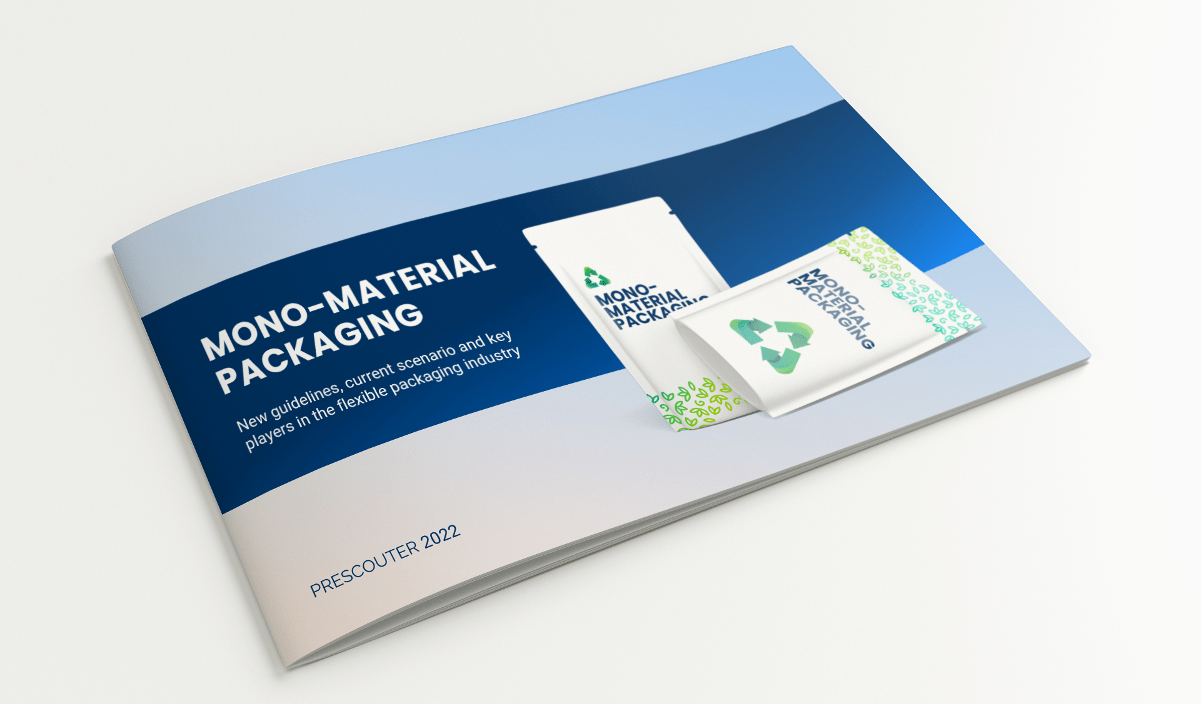
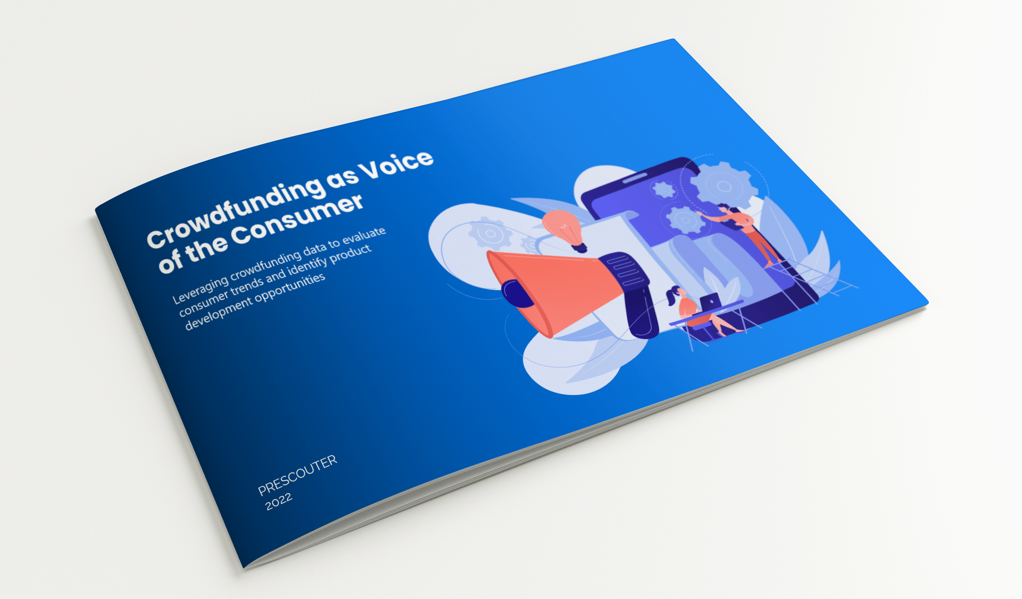
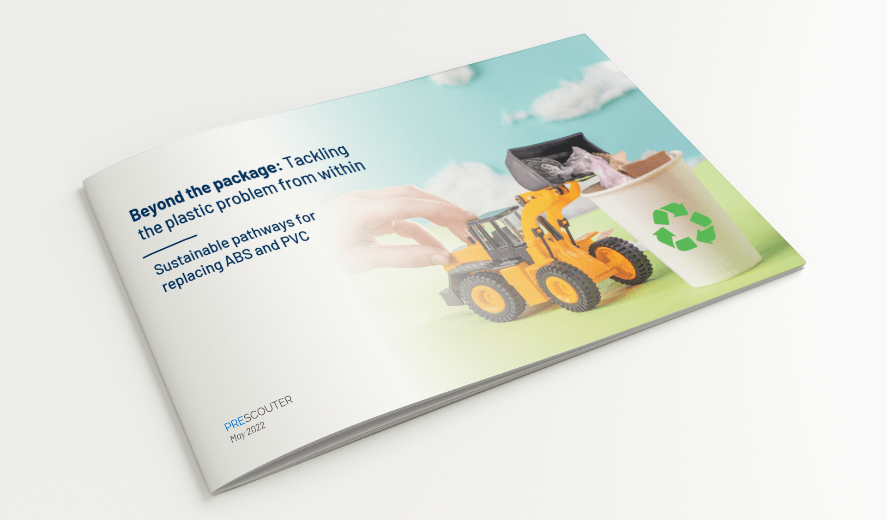
Other reports from PreScouter that you might like
Mono-Material Packaging: New guidelines, current scenario, and key players
Crowdfunding as Voice of the Consumer
Beyond the package: Tackling the plastic problem from within
Engage our network of experts and researchers on your topic.
CONTACT US HERE

Slide 45
About PreScouter
PRESCOUTER PROVIDES CUSTOMIZED RESEARCH AND ANALYSIS
PreScouter helps clients gain competitive advantage by providing customized global research. We act as an extension to your in-house research and business data teams to provide you with a holistic view of trends, technologies, and markets.
Our model leverages a network of 4,000+ advanced degree researchers, industrial experts, engineers, and analysts across the globe to tap into information from small businesses, national labs, markets, universities, patents, startups, and entrepreneurs.
CLIENTS RELY ON US FOR:
Innovation Discovery: PreScouter provides clients with a constant flow of high-value opportunities and ideas by keeping you up to date on new and emerging technologies and businesses.
Privileged Information: PreScouter interviews innovators to uncover emerging trends and non-public information.
Customized Insights: PreScouter finds and makes sense of technology and market information to help you make informed decisions.
500+
CLIENTS
WORLDWIDE
5,000+
RESEARCH
REPORTS CREATED
150,000+
HOURS OF RESEARCH
COMPLETED FOR CLIENTS
500+
CLIENTS
WORLDWIDE
4,000+
RESEARCH
REPORTS CREATED
150,000+
HOURS OF RESEARCH
COMPLETED FOR CLIENTS

